Slide 1
S2 Table: ERPs for young adults. (a) N1 at Fz: Simple main effect test after the interaction of ANOVA.
Items | F [F_{(2,32)} in Face at Cong. or Incong.; F_{(1,16)} in Gaze at Neutral, Angry, and Happy] | p | η_{ｐ}² (partial η²)
Face at Cong. | .619 | .545 | .037
Face at Incong. | 1.740 | .192 | .098
Gaze at Neutral | 1.683 | .213 | .095
Gaze at Angry | 1.869 | .191 | .105
Gaze at Happy | .016 | .900 | .001

Slide 2
(b) Latency of P2 at Fz: Simple main effect test after the interaction of ANOVA.
Items | F [F_{(2,32)} in Face at Cong. or Incong.; F_{(1,16)} in Gaze at Neutral, Angry, and Happy] | p | η_{ｐ}² (partial η²)
Face at Cong. | 2.959 | .066† | .156
Face at Incong. | .975 | .388 | .057
Gaze at Neutral | 1.442 | .247 | .083
Gaze at Angry | 4.148 | .059† | .206
Gaze at Happy | 1.136 | .302 | .066
†, p < .1.

Slide 3
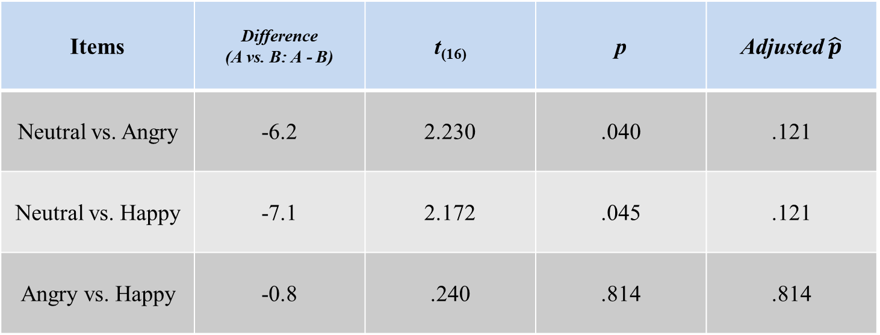
(c) Latency of P2 at Fz: Multiple comparisons between Face conditions at Cong.
Items | Difference (A vs. B: A - B) | t₍₁₆₎ | p | Adjusted $\hat{p}$
Neutral vs. Angry | -6.2 | 2.230 | .040 | .121
Neutral vs. Happy | -7.1 | 2.172 | .045 | .121
Angry vs. Happy | -0.8 | .240 | .814 | .814

Slide 4
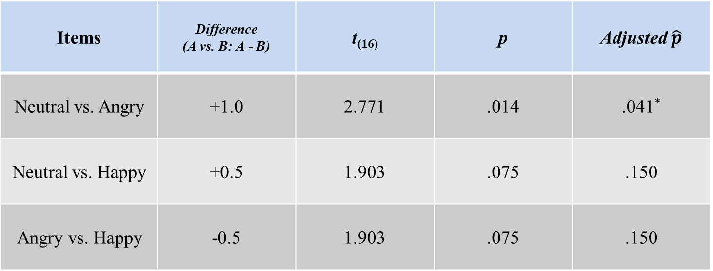
(d) N2 at Fz: Multiple comparisons between Face conditions.
Items | Difference (A vs. B: A - B) | t₍₁₆₎ | p | Adjusted $\hat{p}$
Neutral vs. Angry | +1.0 | 2.771 | .014 | .041*
Neutral vs. Happy | +0.5 | 1.903 | .075 | .150
Angry vs. Happy | -0.5 | 1.903 | .075 | .150
*, p < .05.

Slide 5
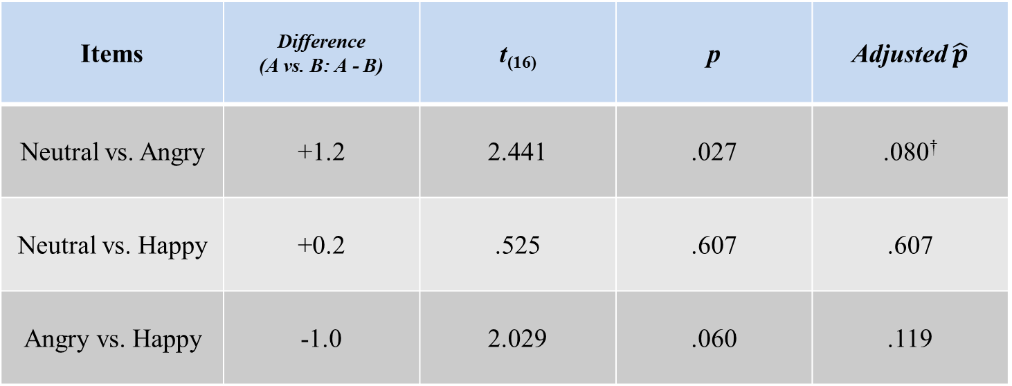
(e) P3 at Pz: Multiple comparisons between Face conditions.
Items | Difference (A vs. B: A - B) | t₍₁₆₎ | p | Adjusted $\hat{p}$
Neutral vs. Angry | +1.2 | 2.441 | .027 | .080†
Neutral vs. Happy | +0.2 | .525 | .607 | .607
Angry vs. Happy | -1.0 | 2.029 | .060 | .119
†, p < .1.

Slide 6
(f) P3 at Pz: Simple main effect test after the interaction of ANOVA.
Items | F [F_{(2,32)} in Face at Cong. or Incong.; F_{(1,16)} in Gaze at Neutral, Angry, and Happy] | P | η_{ｐ}² (partial η²)
Face at Cong. | 4.068 | .027* | .203
Face at Incong. | 6.903 | .003** | .301
Gaze at Neutral | 5.050 | .039* | .240
Gaze at Angry | 2.499 | .134 | .135
Gaze at Happy | 6.760 | .019* | .297
**, p < .01; *, p < .05.

Slide 7
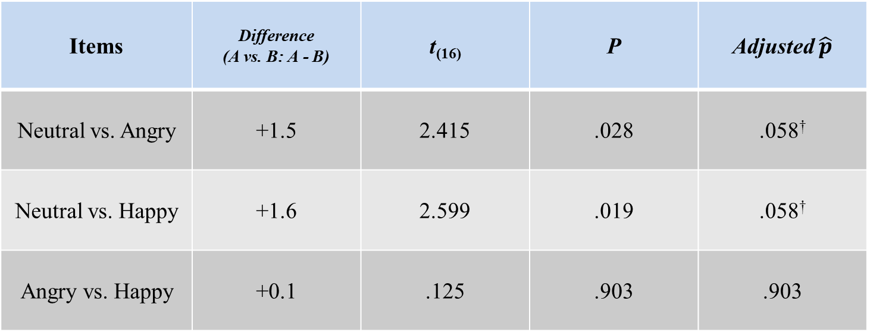
(g) P3 at Pz: Multiple comparisons between Face conditions at Cong.
Items | Difference (A vs. B: A - B) | t₍₁₆₎ | P | Adjusted $\hat{p}$
Neutral vs. Angry | +1.5 | 2.415 | .028 | .058†
Neutral vs. Happy | +1.6 | 2.599 | .019 | .058†
Angry vs. Happy | +0.1 | .125 | .903 | .903
†, p < .1.

Slide 8
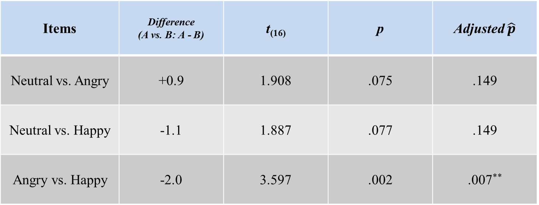
(h) P3 at Pz: Multiple comparisons between Face conditions at Incong.
Items | Difference (A vs. B: A - B) | t₍₁₆₎ | p | Adjusted $\hat{p}$
Neutral vs. Angry | +0.9 | 1.908 | .075 | .149
Neutral vs. Happy | -1.1 | 1.887 | .077 | .149
Angry vs. Happy | -2.0 | 3.597 | .002 | .007**
**, p < .01.

