Slide 1
S1 Table: ERPs for preschoolers. (a) Latency of N2 at Fz: Simple main effect test after the interaction of ANOVA.
Items | F [F_{(2,32)} in Face at Cong. or Incong.; F_{(1,16)} in Gaze at Neutral, Angry, and Happy] | p | η_{ｐ}² (partial η²)
Face at Cong. | 2.371 | .110 | .129
Face at Incong. | 1.580 | .222 | .090
Gaze at Neutral | 8.194 | .011* | .339
Gaze at Angry | 1.290 | .273 | .075
Gaze at Happy | 1.653 | .217 | .094
*, p < .05.

Slide 2
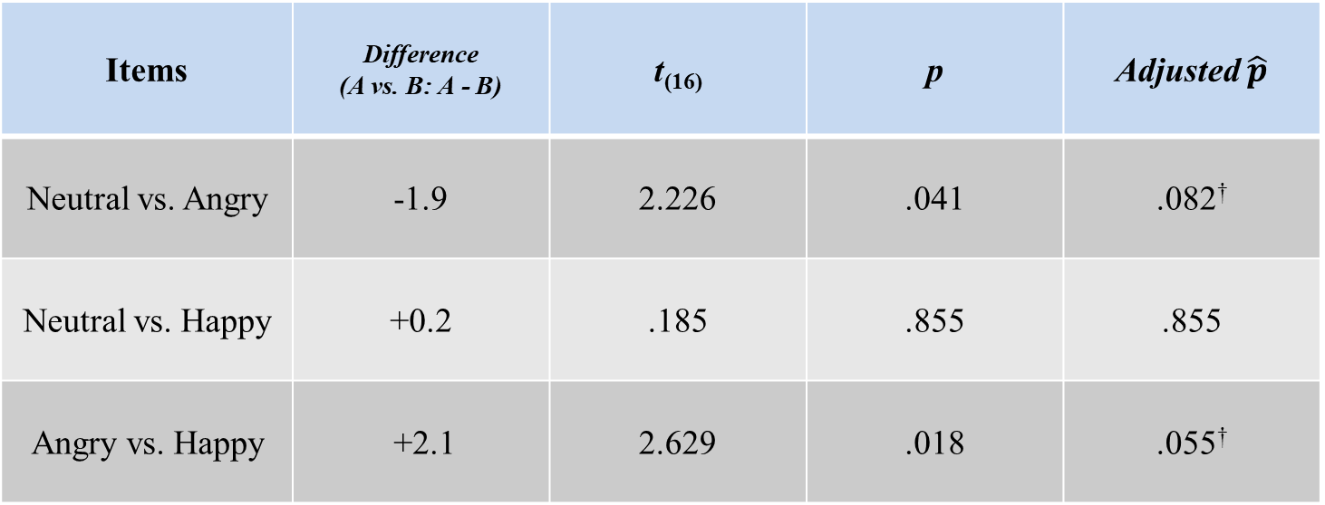
(b) Late response at Fz: Multiple comparisons between Face conditions.
Items | Difference (A vs. B: A - B) | t₍₁₆₎ | p | Adjusted $\hat{p}$
Neutral vs. Angry | -1.9 | 2.226 | .041 | .082†
Neutral vs. Happy | +0.2 | .185 | .855 | .855
Angry vs. Happy | +2.1 | 2.629 | .018 | .055†
†, p < .1.

Slide 3
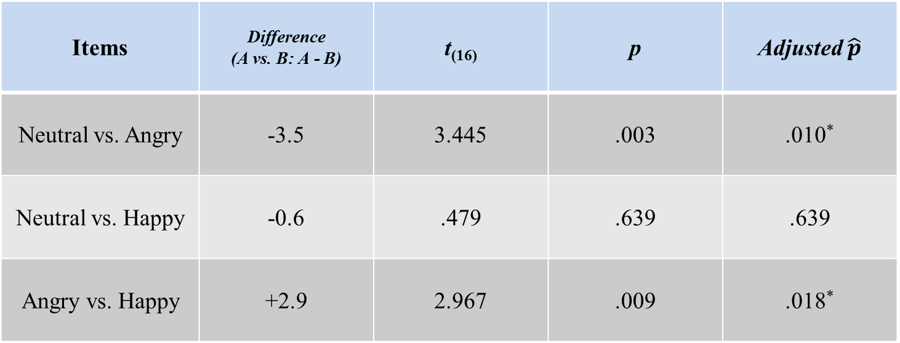
(c) P3 at Cz: Multiple comparisons between Face conditions.
Items | Difference (A vs. B: A - B) | t₍₁₆₎ | p | Adjusted $\hat{p}$
Neutral vs. Angry | -3.5 | 3.445 | .003 | .010*
Neutral vs. Happy | -0.6 | .479 | .639 | .639
Angry vs. Happy | +2.9 | 2.967 | .009 | .018*
*, p < .05.

Slide 4
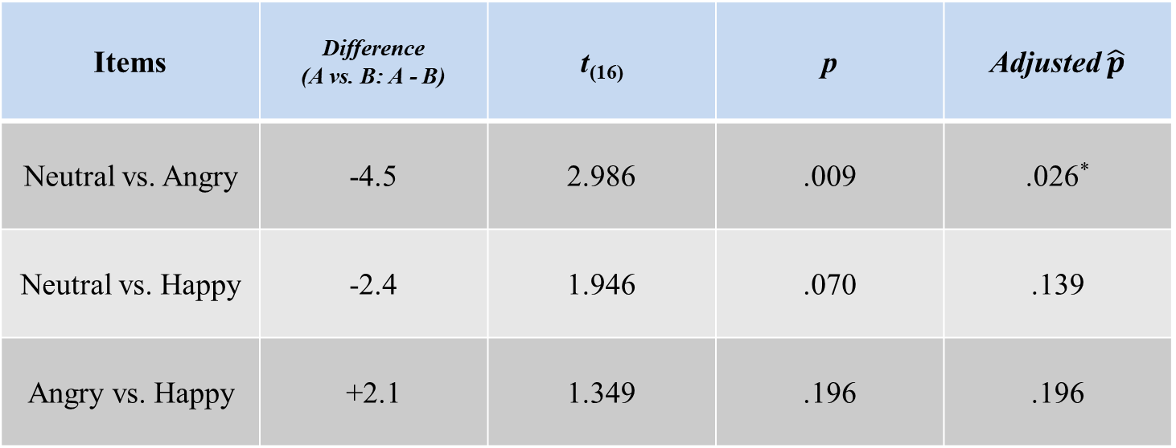
(d) P3 at Pz: Multiple comparisons between Face conditions.
Items | Difference (A vs. B: A - B) | t₍₁₆₎ | p | Adjusted $\hat{p}$
Neutral vs. Angry | -4.5 | 2.986 | .009 | .026*
Neutral vs. Happy | -2.4 | 1.946 | .070 | .139
Angry vs. Happy | +2.1 | 1.349 | .196 | .196
*, p < .05.

