Slide 1
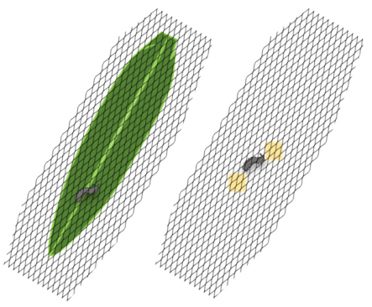
(a)
(b)
S. littoralis
Control
S1 Fig. Setup of Spodoptera littoralis feeding experiments on Nepenthes x ventrata leaves . (a) N. x ventrata (natural hybrid of N. alata x N. ventricosa) plant. (b) S. littoralis larvae together with the leaf were covered with a PET bag to prevent escaping of the larvae. For control, larvae were placed close to the plant but fed on artificial diet.

