Slide 1
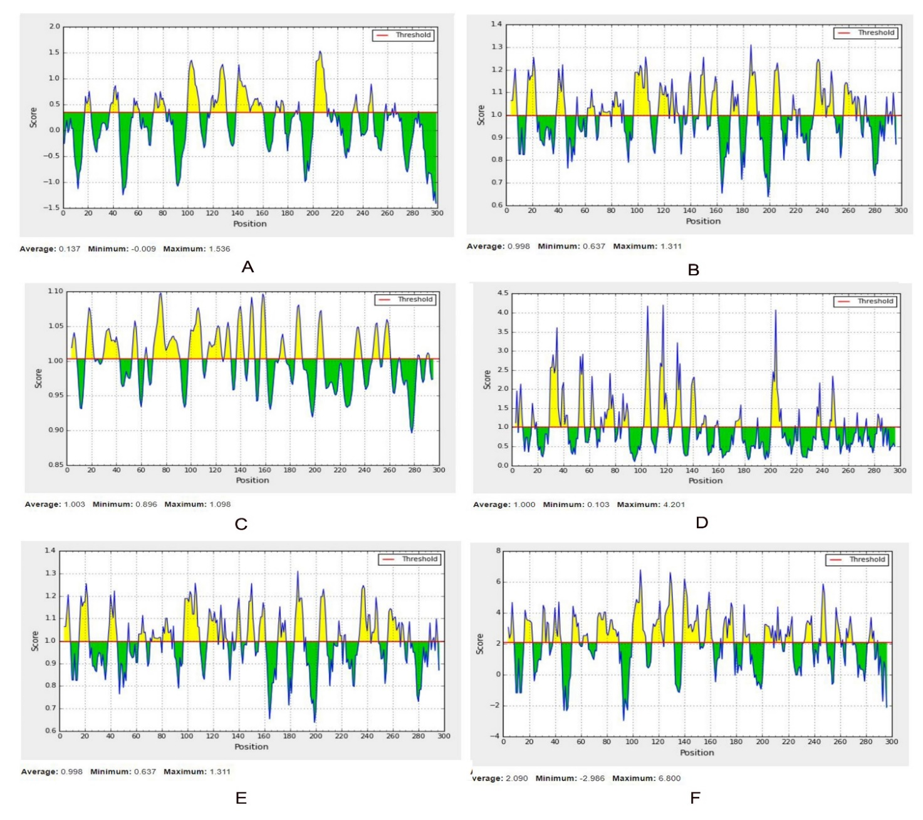
S2 Fig. B-cell epitope prediction of Flagellar hook-associated protein (A: Linear, B: Beta-turn, C: Flexibility, D: Surface Accessibility, E: Antigenicity, F: Hydrophilicity). For each graph, X-axis and Y-axis represent the position and score. Residues that fall above the threshold value are shown in yellow color while the highest peak in yellow color identifies most favored position.

