Slide 1
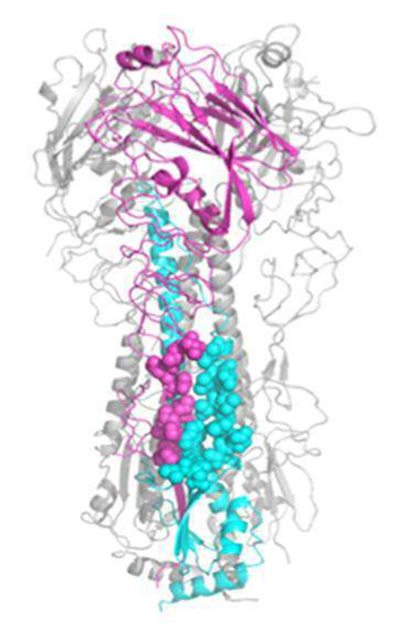
(a)
(b)
F10
A/Vietnam/1203/2004
CT120
A/Vietnam/1203/2004
CT149
A/Hong Kong/1/1968

