Slide 1
Representative figures of 22 Patients with predominant CMs

Slide 2
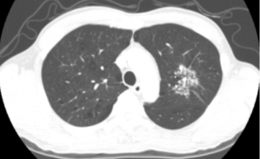
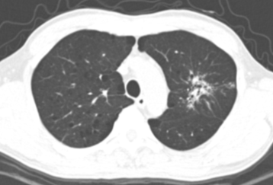
1) ID : 1, 78/M
Pre diagnostic CT: 2010-12-17
Diagnostic CT: 2013-03-22
Total CT score
- initial: 6
- follow up: 10
Pre diagnostic CT - 2010-12-17
Diagnostic CT - 2010-12-17
Notes:
17175832 김상호 2010-12-17
Ok

Slide 3
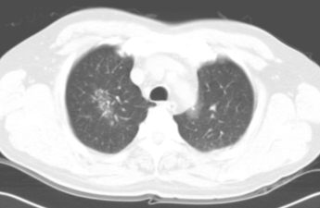
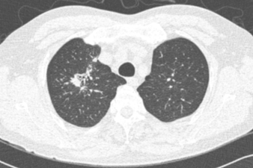
2) ID : 2, 68/M
Pre diagnostic CT: 2007-02-07
Diagnostic CT: 2013-05-10
Total CT score
- initial : 3
- follow up : 8
Pre diagnostic CT – 2007-02-07
Diagnostic CT – 2013-05-10
Notes:
25823808 유덕준 2007-02-07
Ok

Slide 4
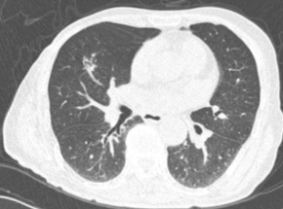
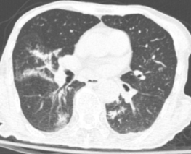
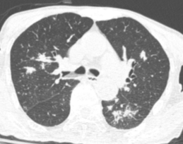
3) ID : 3, 88/M
Pre diagnostic CT: 2010-03-18
Diagnostic CT: 2014-08-16
Total CT score
- initial : 4
- follow up : 71
Pre diagnostic CT – 2010-03-18
Diagnostic CT – 2014-08-16
Notes:
28392738 강영복 2010-03-18
Ok

Slide 5
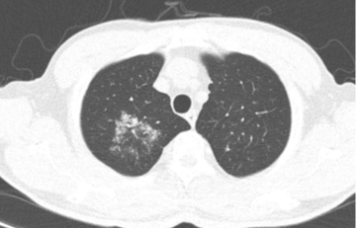
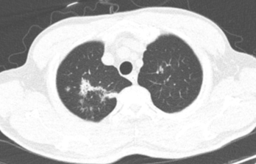
4) ID : 4, 79/M
Pre diagnostic CT: 2013-09-02
Diagnostic CT: 2013-10-21
Total CT score
- initial : 2
- follow up : 14
Pre diagnostic CT – 2013-09-02
Diagnostic CT – 2013-10-21
Notes:
33941341 정인철 2013-10-21
Ok

Slide 6
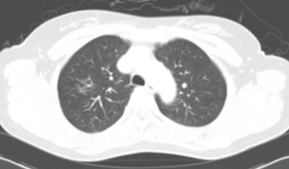
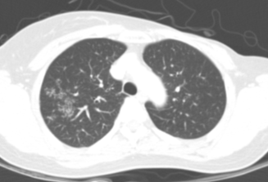
5) ID 5, 56/F
Pre diagnostic CT: 2009-05-16
Diagnostic CT: 2013-06-05
Total CT score
- initial : 1
- follow up : 7
Pre diagnostic CT – 2009-05-16
Diagnostic CT – 2013-06-05
Notes:
38952555 차미숙 2009-05-16
Ok

Slide 7
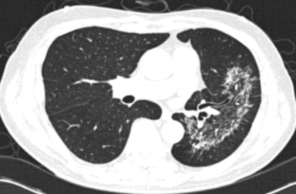
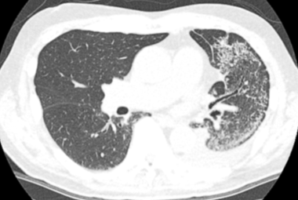
6) ID 6, 84/M
Pre diagnostic CT: 2009-06-02
Diagnostic CT: 2014-02-14
Total CT score
- initial : 37
- follow up : 68
Pre diagnostic CT – 2009-06-02
Diagnostic CT – 2014-02-14
Notes:
39059529 구경열 2009-06-02
Ok. Interval CT있고 2011년 CT와 변화가 없다가 2013년 CT에서 일부 active로 전환. Typical한 course를 보여주는 듯 하구나

Slide 8
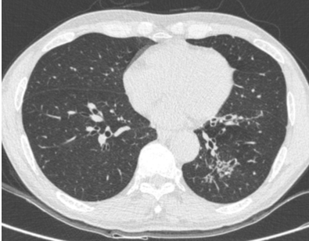
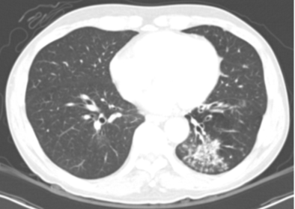
7) ID 7, 71/M
Pre diagnostic CT: 2014-10-22
Diagnostic CT: 2015-12-30
Total CT score
- initial : 2
- follow up : 12
Pre diagnostic CT – 2014-10-22
Diagnostic CT – 2015-12-30
Notes:
39498643 서두원 2014-10-22
Ok

Slide 9
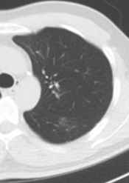
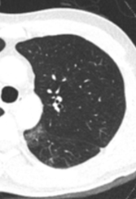
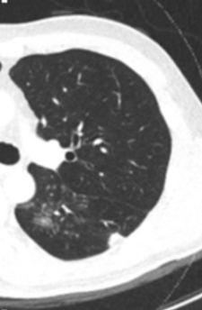
8) ID 8, 55/M
Pre diagnostic CT: 2014-02-19
Diagnostic CT: 2018-02-11
Total CT score
- initial : 1
- follow up : 10
Pre diagnostic CT – 2014-02-19
Diagnostic CT 2018-02-11
Notes:
47251155 고석빈 2014-02-19
Ok

Slide 10
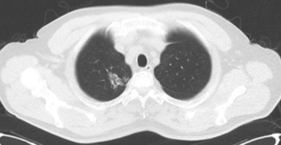
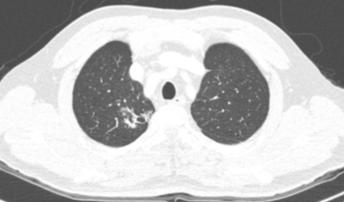
9) ID 9, 65/M
Pre diagnostic CT: 2017-09-23
Diagnostic CT: 2018-03-19
Total CT score
- initial : 4
- follow up : 5
Pre diagnostic CT – 2017-09-23
Diagnostic CT – 2018-03-19
Notes:
50502222 함종식 2018-01-30
Ok

Slide 11
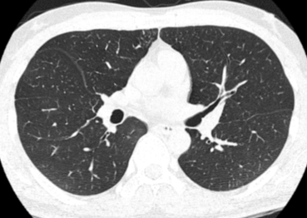
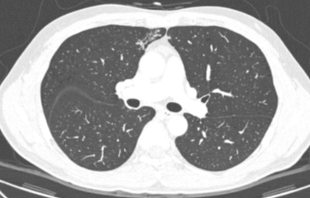
10) ID 10, 57/M
Pre diagnostic CT: 2015-02-24
Diagnostic CT: 2018-07-01
Total CT score
- initial : 1
- follow up : 3
Pre diagnostic CT – 2013-10-15
Diagnostic CT – 2018-07-01
Notes:
48644091 장현진 2018-04-06
Ok

Slide 12
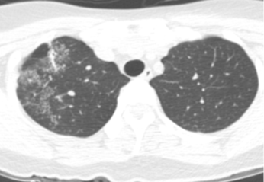
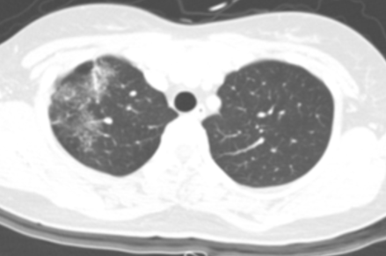
11) ID 11, 45/F
Pre diagnostic CT: 2012-01-05
Diagnostic CT: 2013-01-22
Total CT score
- initial : 12
- follow up : 14
Pre diagnostic CT – 2012-01-05
Diagnostic CT – 2013-01-22
Notes:
36796999 박수원 2013-01-22
Ok 이환자는 2012-1-5 thyroid CT에서 cover되었으며 FU 있는 환자군으로 분석하자!

Slide 13
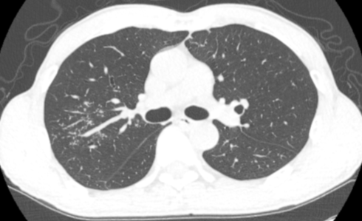
12) ID 12, 66/M
Diagnostic CT: 2017-12-13
Total CT score: 4
Notes:
13976468 노만식 2017-12-13
Ok

Slide 14
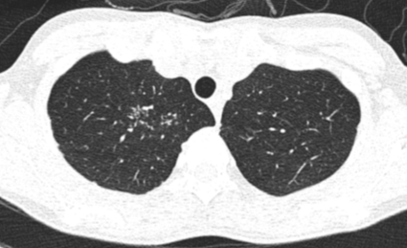
13) ID 13, 50/F
Diagnostic CT: 2016-04-04
Total CT score: 4
Notes:
28782944 권수현 2016-04-04
Ok

Slide 15
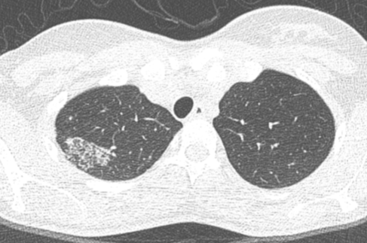
14) ID 14, 31/F
Diagnostic CT: 2013-11-14
Total CT score: 12
Notes:
31373771 전정연 2013-11-14
Ok

Slide 16
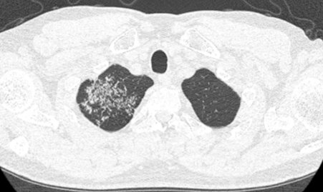
15) ID 15, 49/M
Diagnostic CT: 2017-02-09
Total CT score: 7
Notes:
36231865 이강희 2017-02-09
Ok

Slide 17
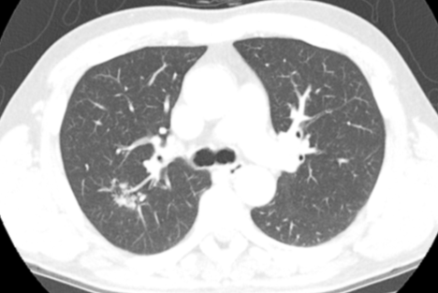
16) ID 16, 54/M
Diagnostic CT: 2015-04-24
Total CT score: 4
Notes:
37603540 장우석 2015-05-06

Slide 18
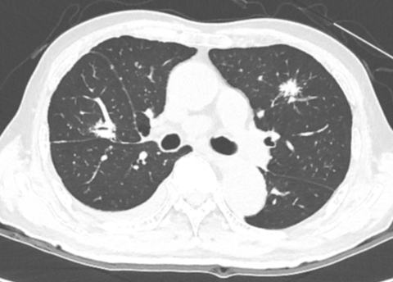
17) ID 17, 82/M
Diagnostic CT: 2016-08-05
Total CT score: 17
Notes:
38519934 김시현 2016-08-05
Ok

Slide 19
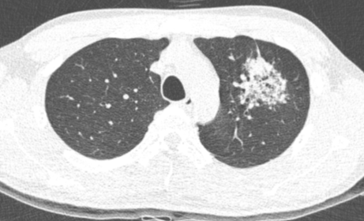
18) ID 18, 34/M
Diagnostic CT: 2014-08-04
Total CT score: 8
Notes:
39995005 이동운 2014-08-04
Ok

Slide 20
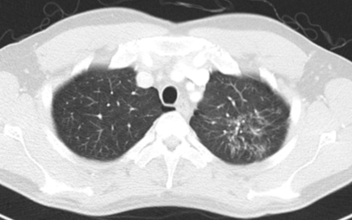
19) ID 19, 55/M
Diagnostic CT: 2018-05-25
Total CT score: 12
Notes:
40464354 주종배 2018-05-25
Ok

Slide 21
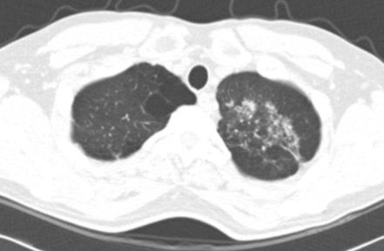
20) ID 20, 47/M
Diagnostic CT: 2014-11-20
Total CT score: 7
Notes:
46150879 박정환 2014-11-20
Ok

Slide 22
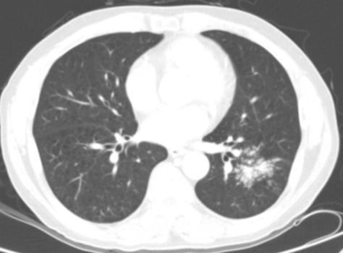
21) ID 21, 58/M
Diagnostic CT: 2016-01-21
Total CT score: 18
Notes:
47767388 전병철 2016-01-21
Ok

Slide 23
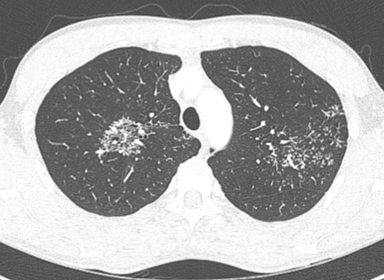
22) ID 22, 44/M
Diagnostic CT: 2016-03-09
Total CT score: 22
Notes:
70768709 조기대 2016-03-09
Ok

