Slide 1
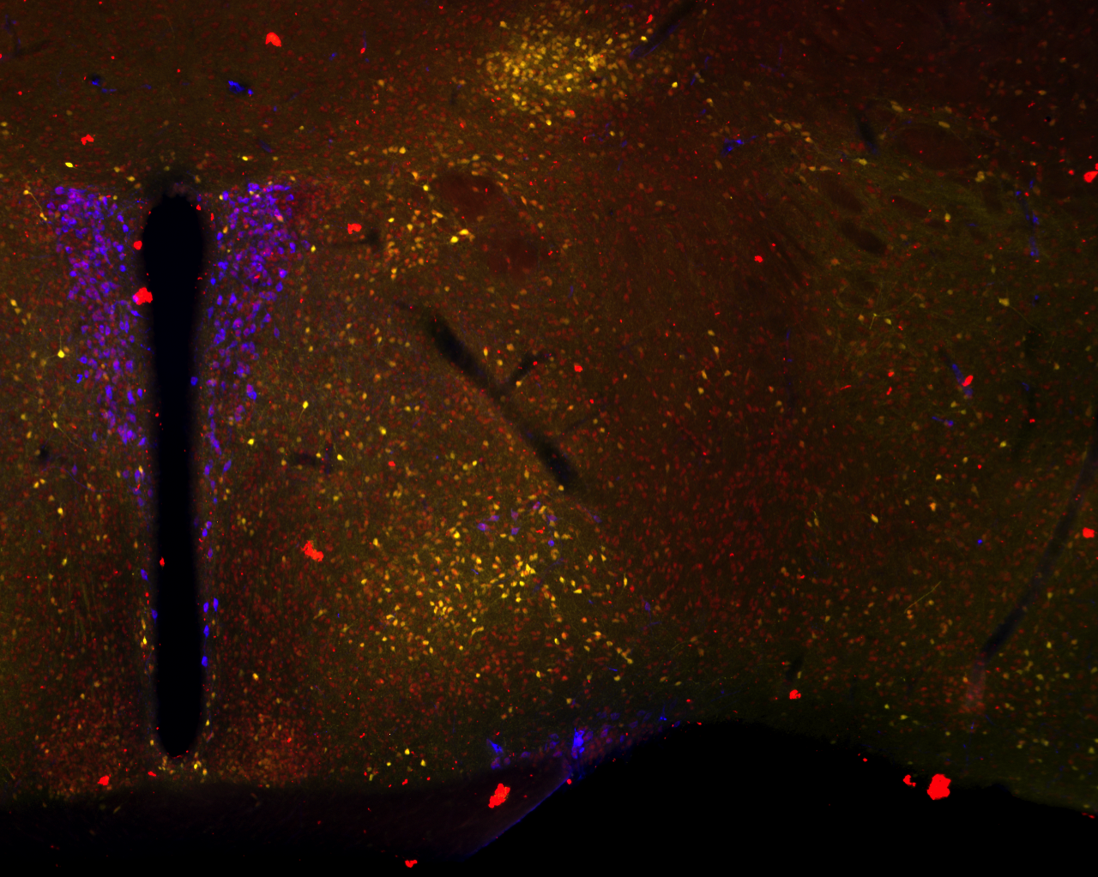
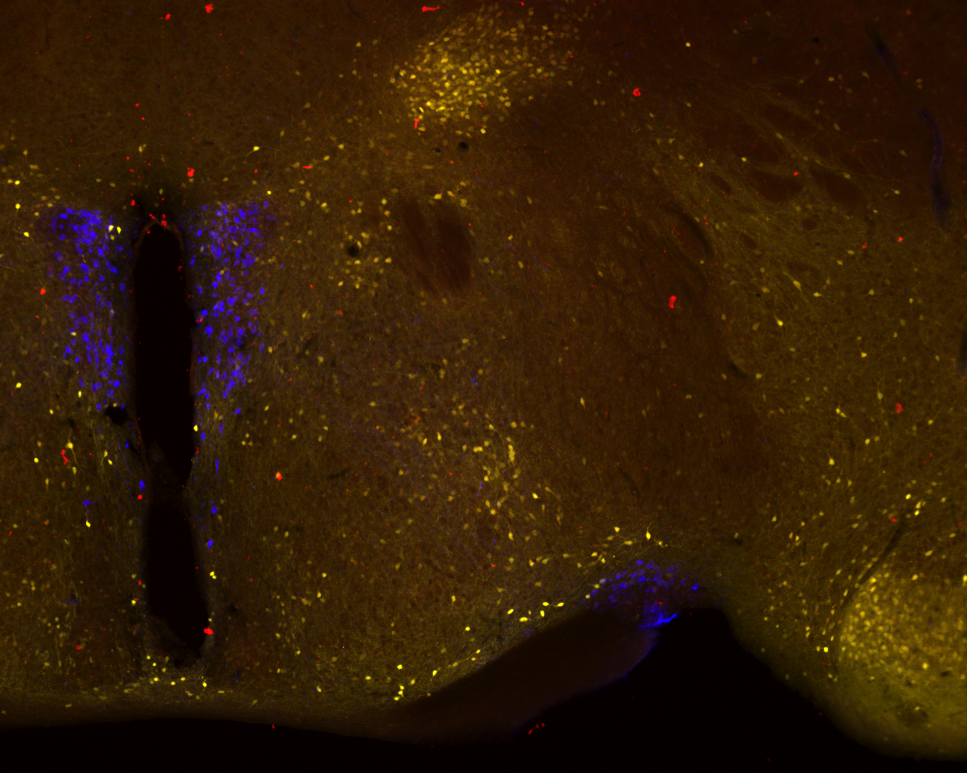
S3 File
SON and PVN in the hypothalamus
Oxtr-Venus
Peg3
Oxt
Merged
WT
PVN
3V
SON
KO
This is a section different from those shown in Fig 5, but shows clearly SON and PVN. In terms of spatial expression pattern, there was no major difference in the oxytocinergic neuron cells between Oxtr^{Venus/+}; Peg3^{+/+} (WT) and Oxtr^{Venus/+}; Peg3^{+/CoKO} (KO) . The scale bar is 0.5 mm. 3V: 3rd Ventricle, PVN: ParaVentricular Nucleus, SON: SupraOptic Nucleus.
Notes:
Scale Bar = 0.5 mm

