Slide 1
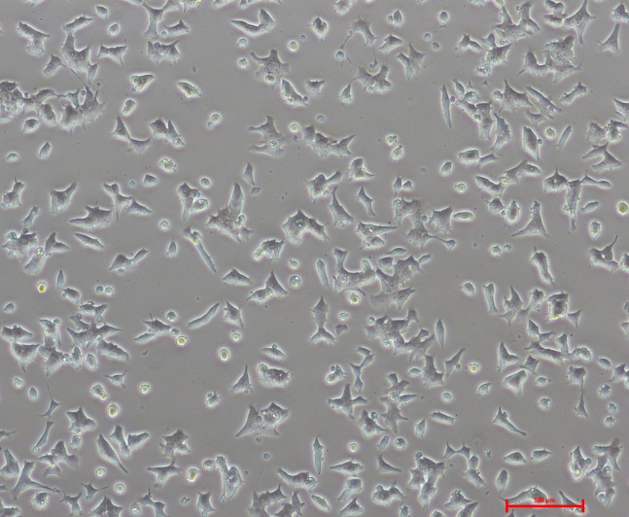
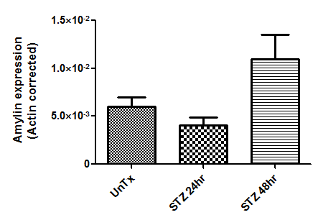
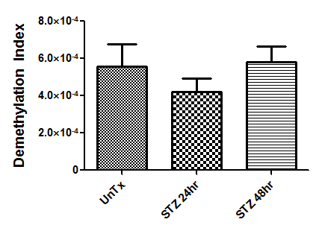
Figure S2
A.
Untreated Control
STZ Treated – 24hr
STZ Treated – 48hr
B.
C.
Amylin Gene Expression – Real Time PCR
Amylin Gene Methylation - DMI

