Slide 1
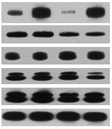
48hr
72hr
siRNA
KD - KD -
G3BP1
active-Ras
total-Ras
p-Erk 1/2
total-Erk 1/2
Actb
Figure S7. G3BP1 knockdown and Ras activity. The protein levels of G3BP1, phosphorylated and total Ras, phosphorylated and total Erk1, 2 in PCI-15B are shown at 48 hr and 72 hr after G3BP1 KD. Beta-actin is used as a loading control.

