Slide 1
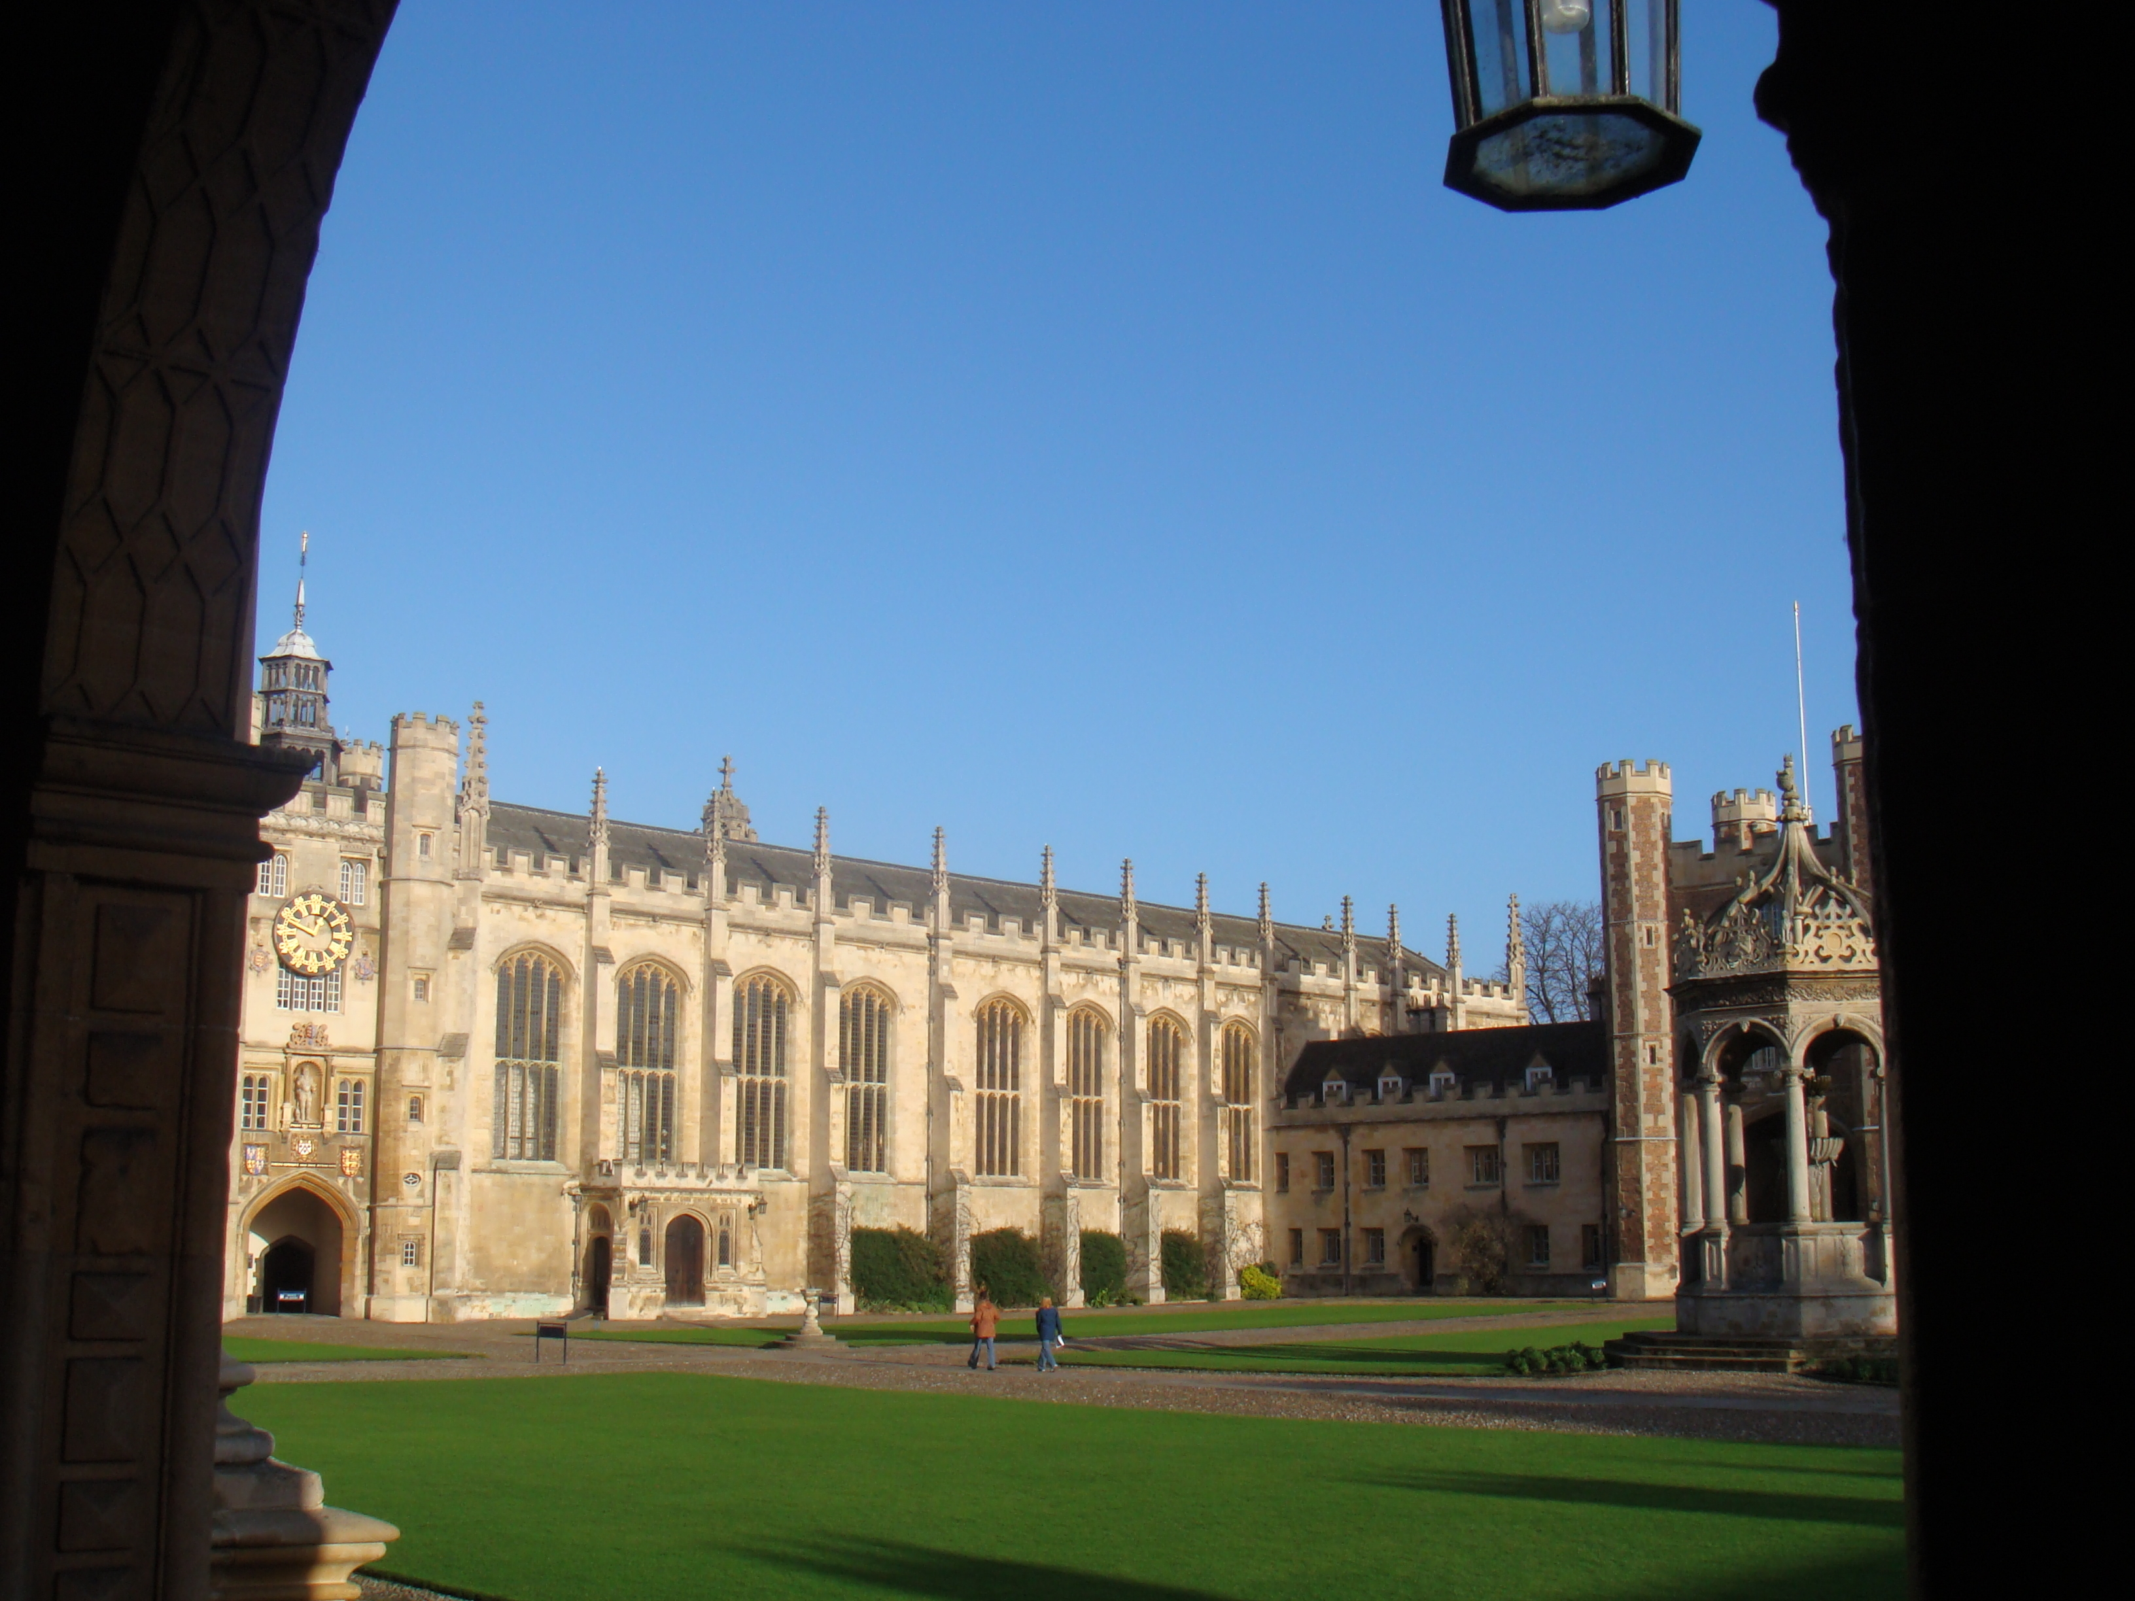
“Materials Chemistry with X-Rays & Neutrons”
Bragg Centennial Symposium, Adelaide, Dec. 6th 2012
Tony Cheetham
Department of Materials Science & Metallurgy
University of Cambridge
Tony Cheetham
Department of Materials Science & Metallurgy
University of Cambridge
Notes:
1

Slide 2
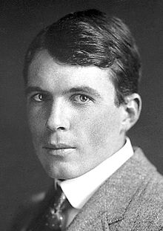
Outline of Talk
Some connections
Trinity College, Cambridge: 1909 ->
The Royal Institution: 1953 ->
Early achievements
– the Bragg equation and the interpretation of X-ray data
– the structures of diamond, zinc blende, rocksalt and fluorite were determined (and quartz by W.H.B)
Materials chemistry with X-rays and neutrons
Ubiquitous use of single crystal X-rays methods
Use of neutrons
Powder methods and Rietveld refinement
Structure determination with powders

Slide 3
Extreme environments
e.g. P and T
Structure
determination
Grazing incidence
X-ray diffraction
with single
crystals
Diffuse scattering
Pole figures and texture
Synchrotron radiation

Slide 4
Impact of Single Crystal Methods
Structure determination
Molecular crystals (organics and inorganics)
Organometallics
Supramolecular compounds
Coordination compounds
Crystalline polymers
Compound semiconductors
Minerals, e.g. aluminosilicates
Metal oxides (ferroelectrics, superconductors, etc)
Metal-organic frameworks
Special applications
High pressure studies
Structure of surfaces

Slide 5
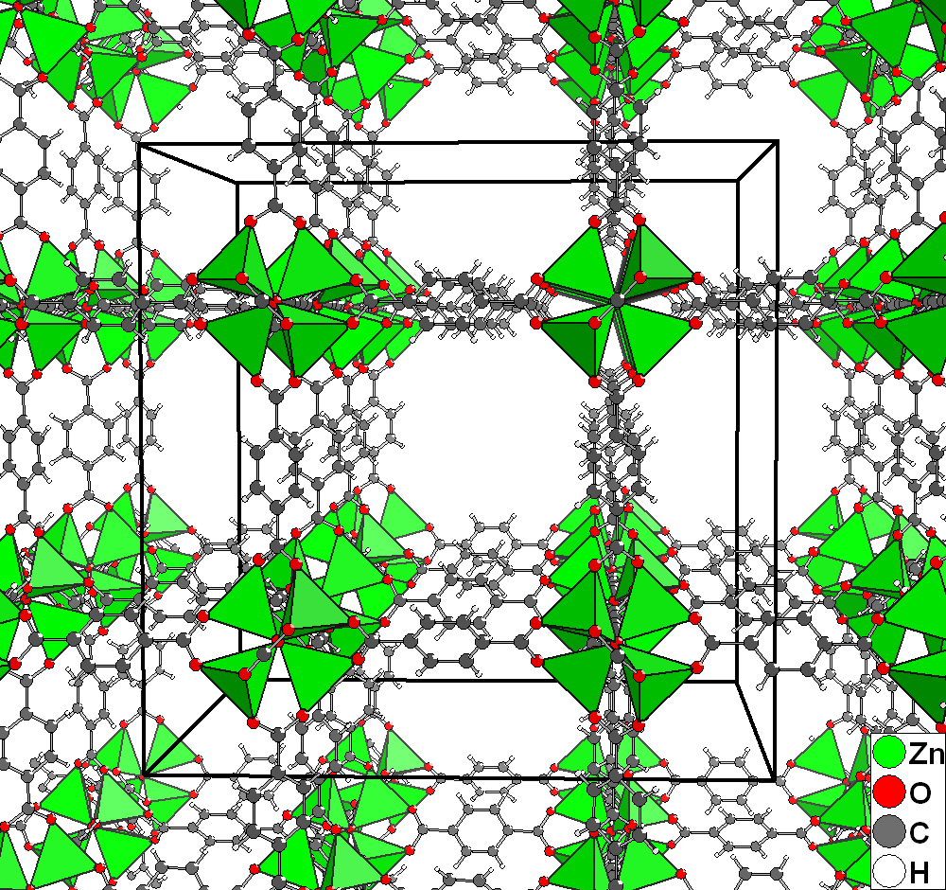
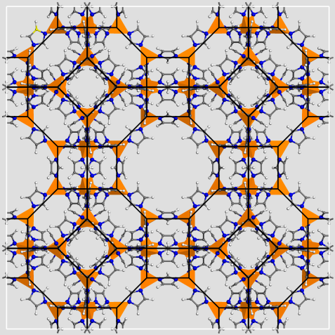
Porous Metal-Organic Frameworks (MOFs)
MOF-5 HKUST-1 ZIF-8
Porous MOFs are being explored for a wide variety of potential applications,
including separations, hydrogen storage, catalysis, sensors and drug delivery
Many frameworks are based upon simple inorganic structures established
by Lawrence Bragg 100 years ago
Many, such as MOF-5 above, adopt primitive cubic structures (pcu)
Notes:
5

Slide 6
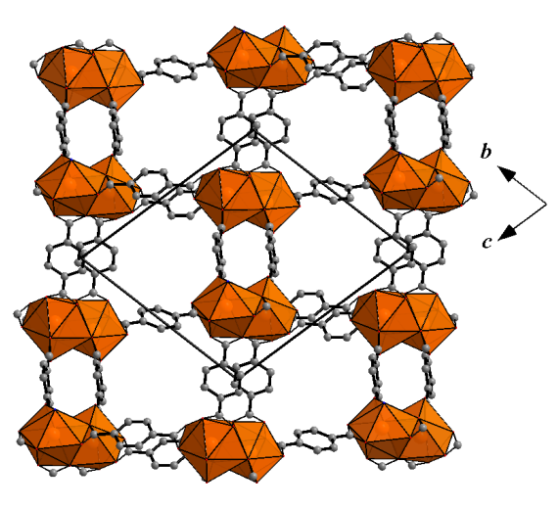
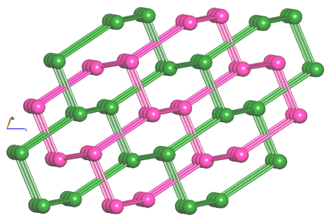
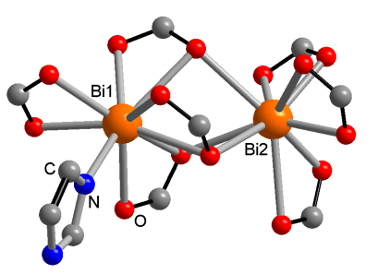
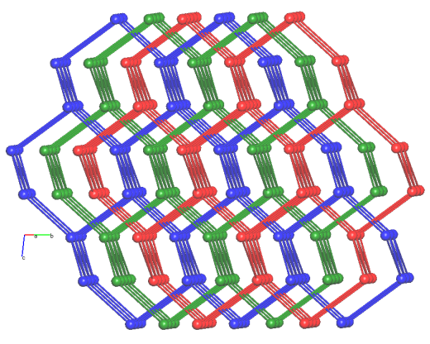
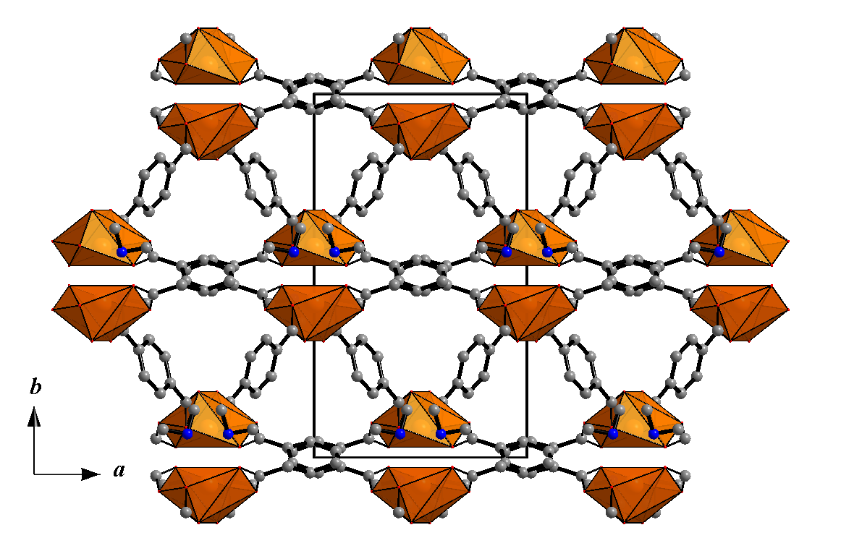
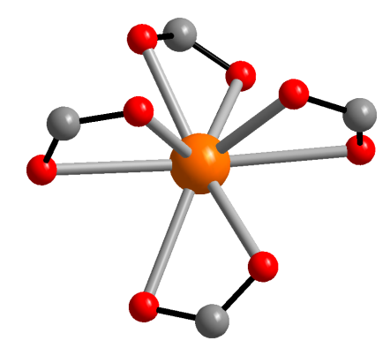
MOFs with the Diamond Topology (dia)
[Bi₄(1,4-BDC)₇(HIm)].(DMA)₂(DMF)₂ adopts a 2-fold interpenetrated dia structure
[Bi(1,4-BDC)₂].(DMA)(DMF) forms a 3-fold interpentrated dia
There are around 500 such MOF structures
W. H. Bragg and W. L. Bragg, Proc. Roy. Soc. A 89, 277 (1913)
A. Thirumurugan and A. K. Cheetham, Eur. J. Inorg. Chem. 2010, 3823
Notes:
6

Slide 7
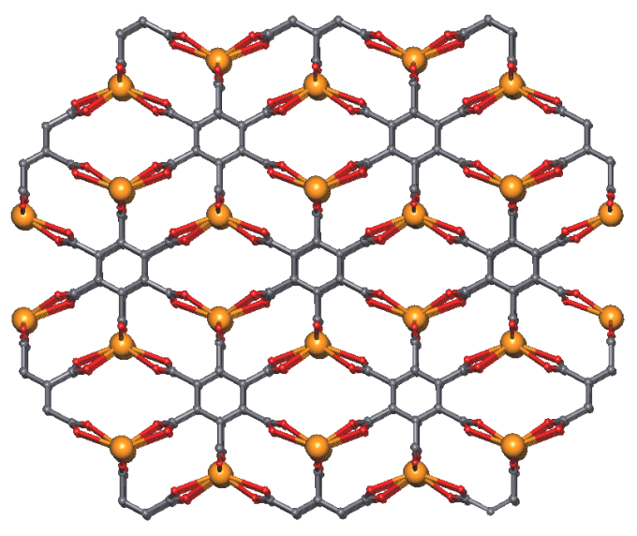
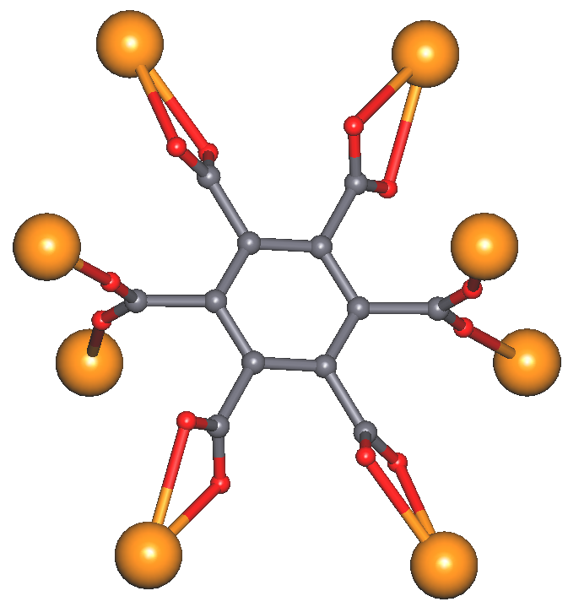
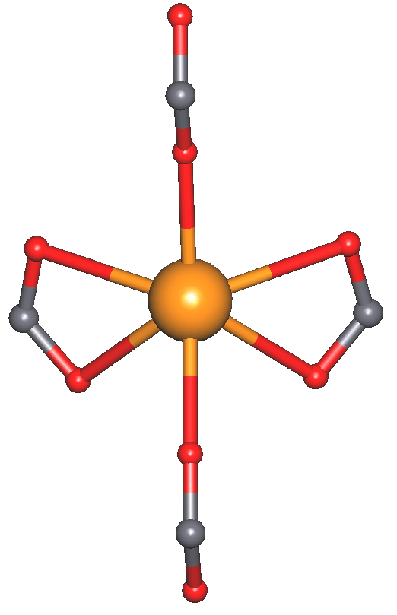
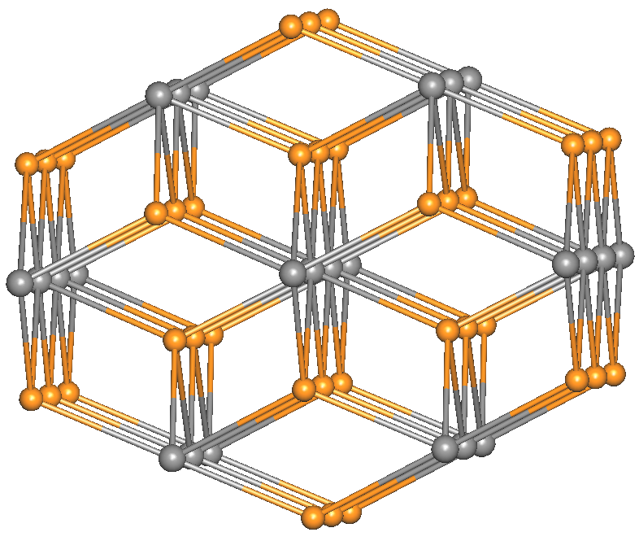
MOFs with the Fluorite Topology (flu)
La₂ (mellitate)(H₂O)₃ flu net
There are 8- and 4- connected nodes
There are around ~35 such structures
W. L. Bragg, Proc. Roy. Soc. A 89, 248 (1913)
SS-Y. Chui, A. Siu, X. Feng, ZY Zhang, TC-W. Mak and ID Williams, Inorg. Chem. Commun., 2001, 4, 467
Notes:
7

Slide 8
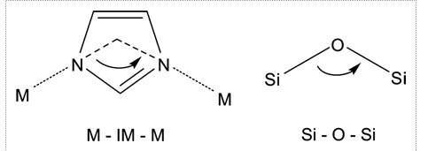
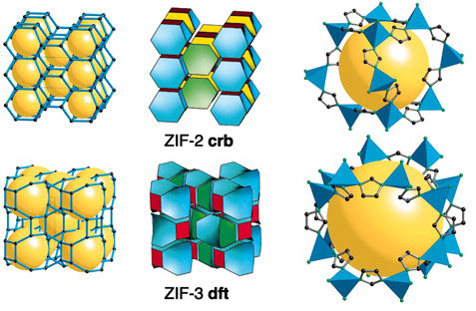
ZIFs: Zeolitic Imidizolate Frameworks
In ZIFs, the Si-O-Si linkages found in silicates are replaced by Zn-Imidazolate-Zn linkages:
Zn(IM)₂ is neutral and forms a range of
zeolite analogues, such as LTA
ZIF LTA-type structure
(i.e. zeolite-A)
The structure of α- and β-quartz
W. H. Bragg and R. E. Gibbs, Proc. Roy. Soc. A 109, 405 (1925)
Notes:
8

Slide 9

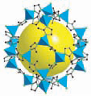
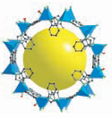
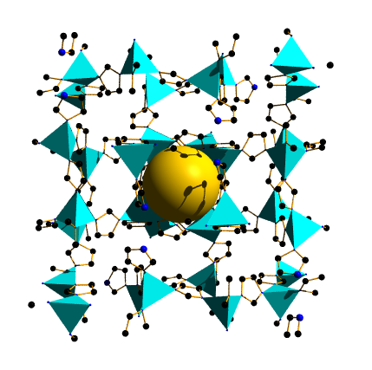
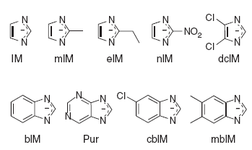
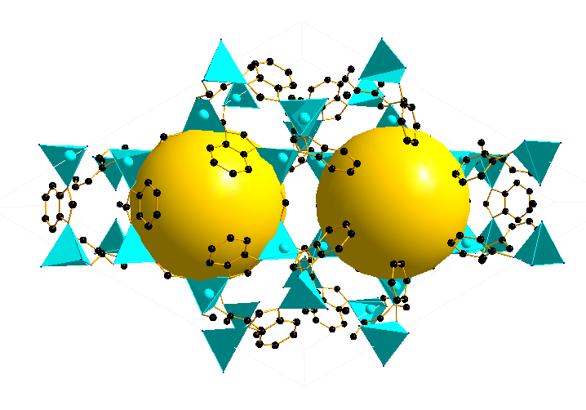
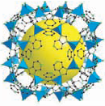
ZIF Topologies are Controlled
by Substituents on the Imidazoles
ZIF-68
(gme)
P6₃/mmc
ZIF-8
(sod)
I-43m
ZIF-4
(cag) Pbca
Dense (zni)
I4₁cd
ZIF-20, (LTA) Pm-3m
ZIF-7 & ZIF-9
(sod) R-3

Slide 10
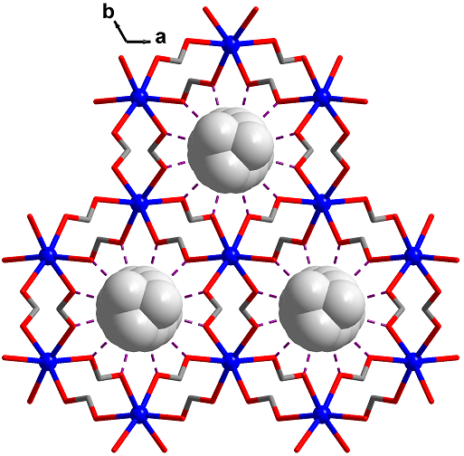
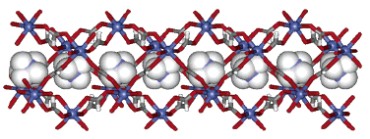
[NH₄][Zn(HCOO)₃]
Highly anisotropic crystal structure, reported in 2006
Homochiral 3D framework
c axis
Triple helices along c axis
Inorg. Chem. 2006, 46, 437.

Slide 11
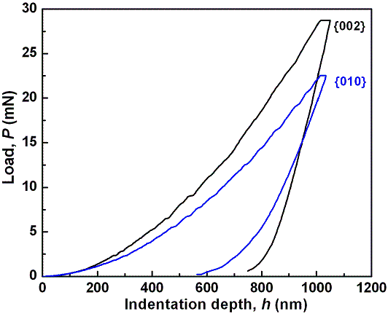
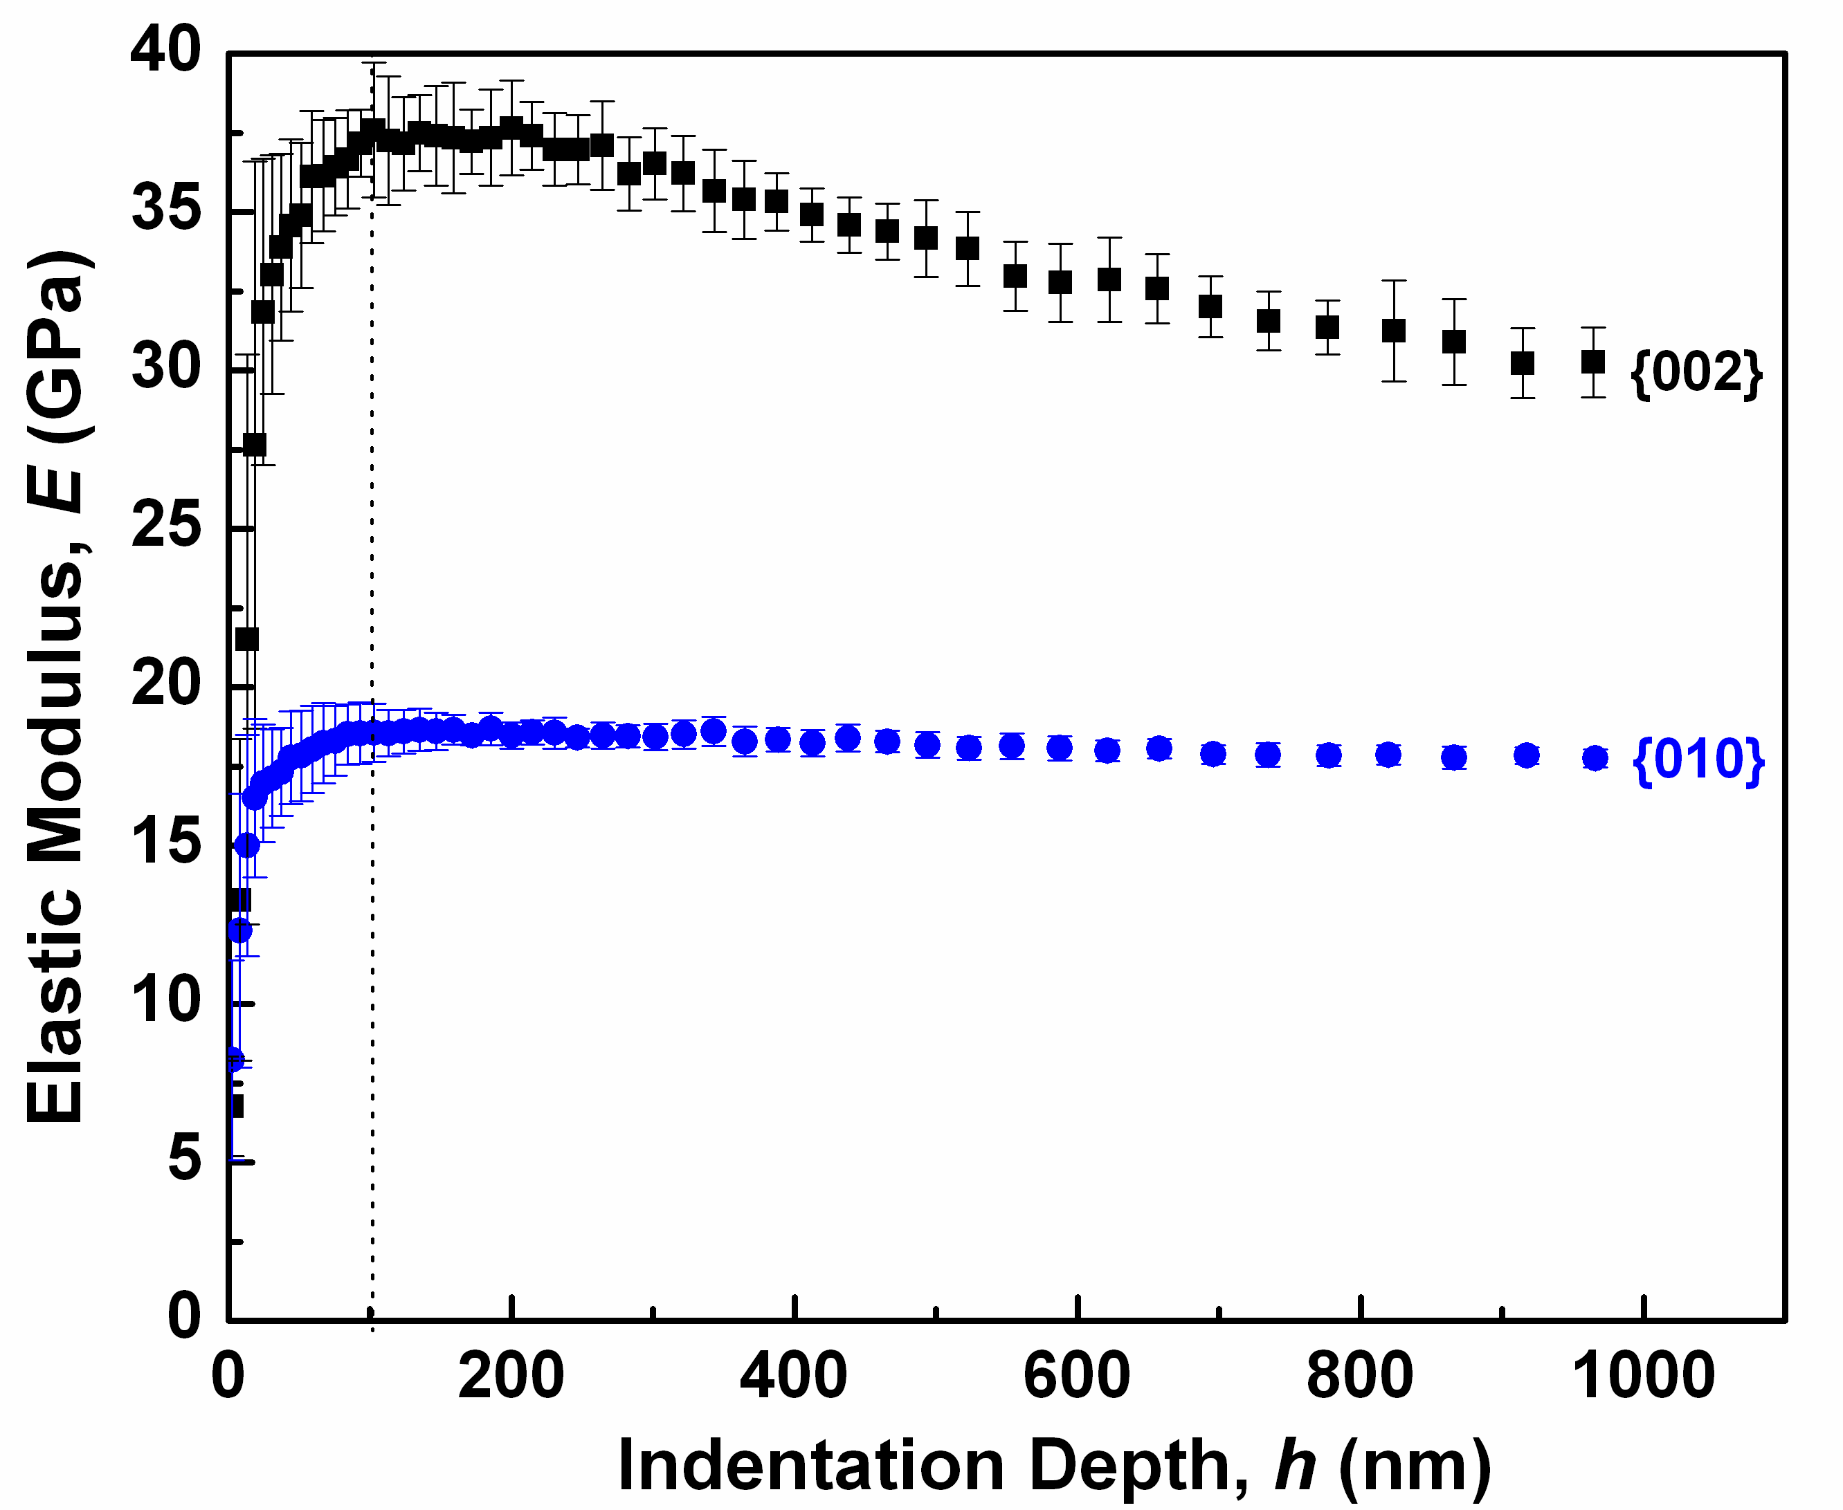
Mechanical Properties of
[NH₄][Zn(HCOO)₃]
Nanoindentation Study: high mechanical anisotropy
P-h plots
Young’s Modulus
// helices
E_{{002}} = 32.50±0.61 GPa
E_{{010}} = 18.22±0.18 GPa
⊥ helices
Li, Probert, Kosa, Bennett, Thirumurugan, Burwood, Parrinell, Howard & Cheetham, JACS (2012)

Slide 12
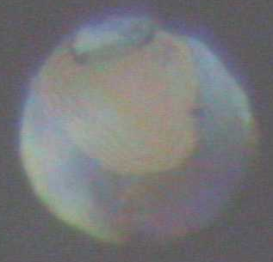
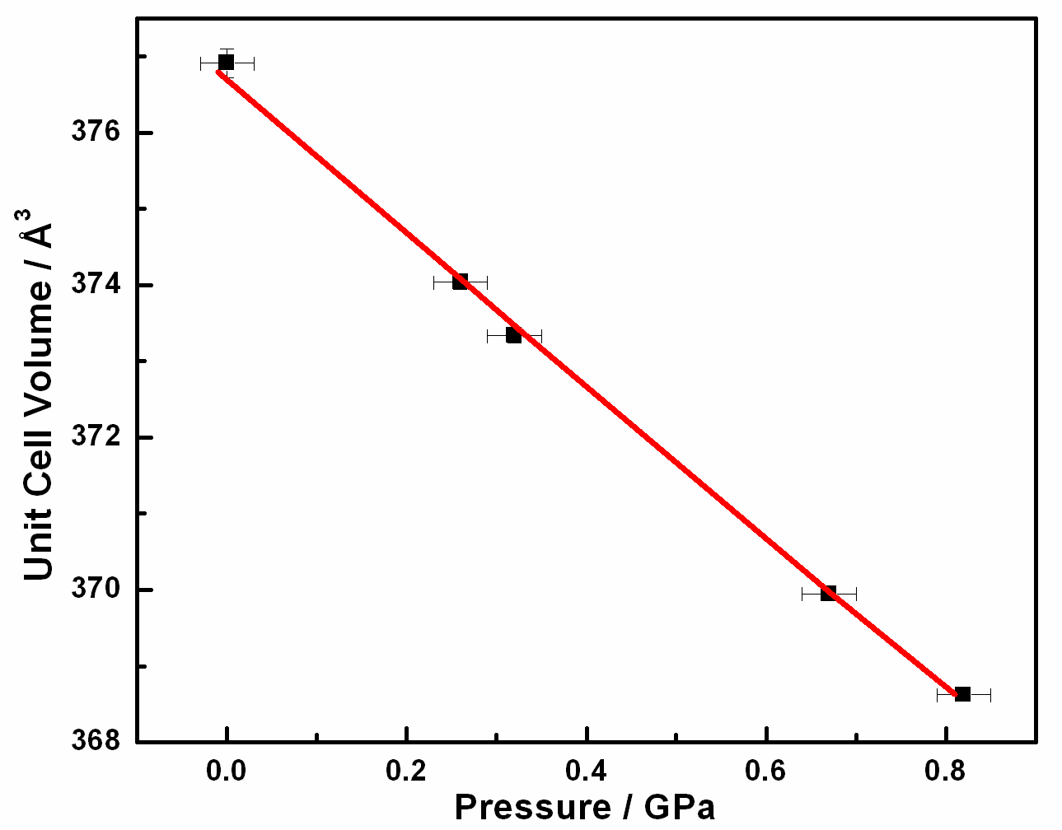
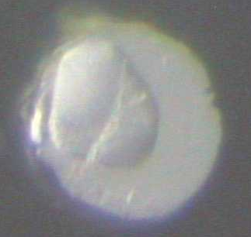
Compressibility of [NH₄][Zn(HCOO)₃]
High-Pressure Single-Crystal X-ray Diffraction
Birch-Murnaghan fitting
K₀ = 35.34±0.63 GPa
0.26 GPa
0.95 GPa
Li, Probert, Kosa, Bennett, Thirumurugan, Burwood, Parrinello, Howard & Cheetham, J. Amer. Chem. Soc. 134 11940, (2012)

Slide 13
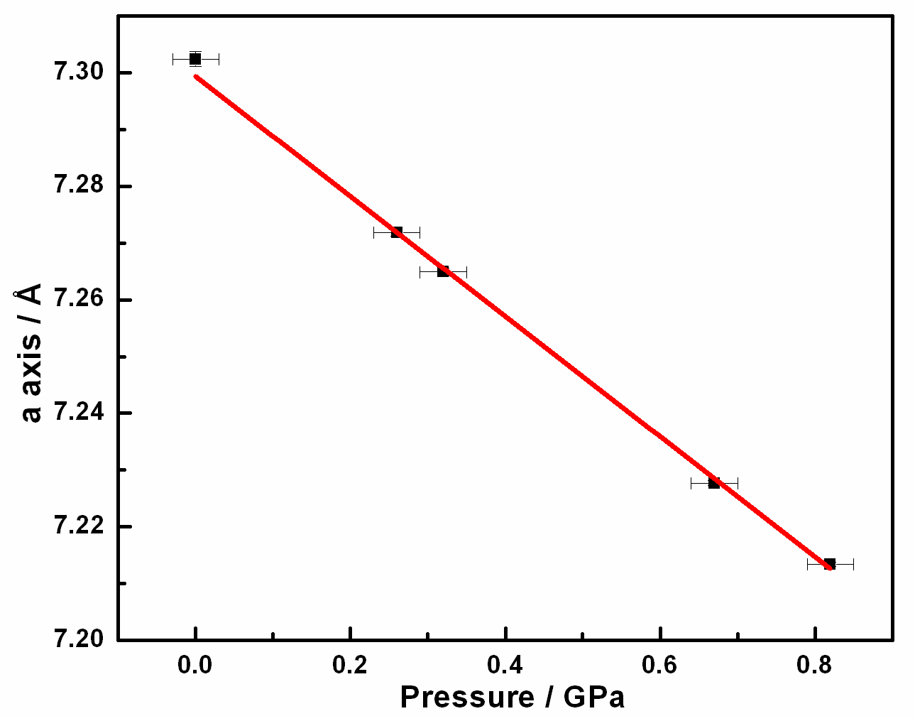
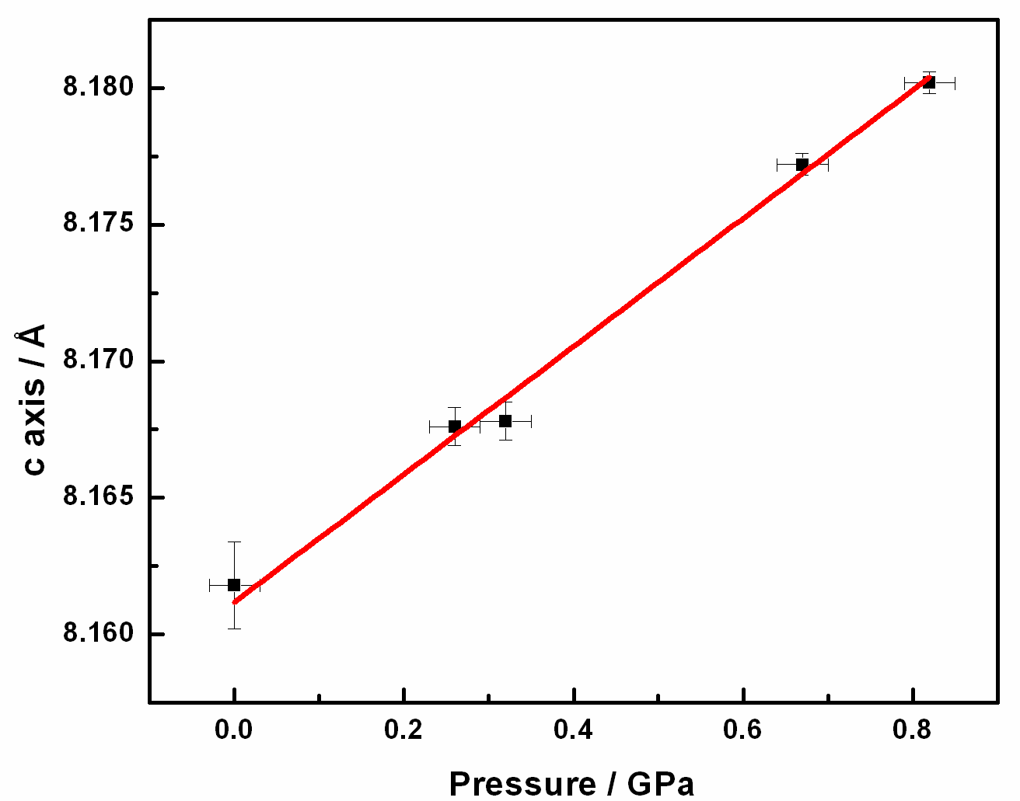
Negative Linear Compressibility in [NH₄][Zn(HCOO)₃]
Li, Probert, Kosa, Bennett, Thirumurugan, Burwood, Parrinello, Howard & Cheetham,
J. Amer. Chem. Soc. 134, 11940 (2012)
Shrinkage of a axis
Expansion of c axis
K_{a} = 14.8 TPa⁻¹
K_{c} = -2.8 TPa⁻¹
Other examples: Inorganic materials: trigonal Se (-1.2 TPa⁻¹); α-cristobalite structured BAsO₄ (-2.0 TPa⁻¹); Ag₃[Co(CN)₆] (-5.0 TPa⁻¹); KMn[Ag(CN)₂]₃ (-12.0 TPa⁻¹)
Organic materials: CD₃DO•D₂O (-3.8 TPa⁻¹) Science 2011, 331, 742; J. Am. Chem. Soc. 2012, DOI: ja20490

Slide 14
Neighbouring element contrast
Location of light atoms, esp. H
Magnetic structure
Neutron Diffraction
Time-of-flight (spallation source)
Extreme environments
Neutron spectroscopy

Slide 15
Qualitative and quantitative analysis
Phase diagrams
Amorphous materials & glasses (pdf)
Powder Diffraction
Rietveld refinement
In situ studies
Structure determination

Slide 16
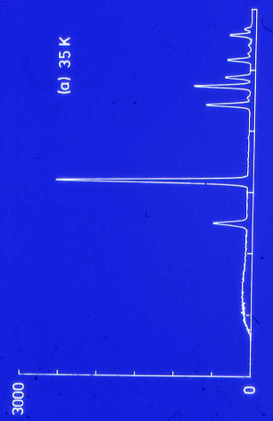
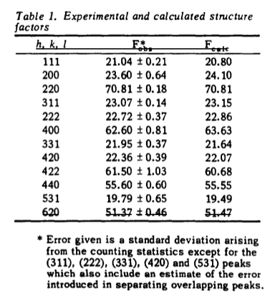
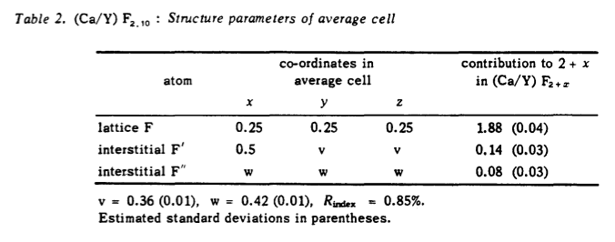
Powder Diffraction – a Poor Man’s Tool!
Pre-1970:
Cheetham et al., Solid State Comm. 8, 171 (1970)

Slide 17
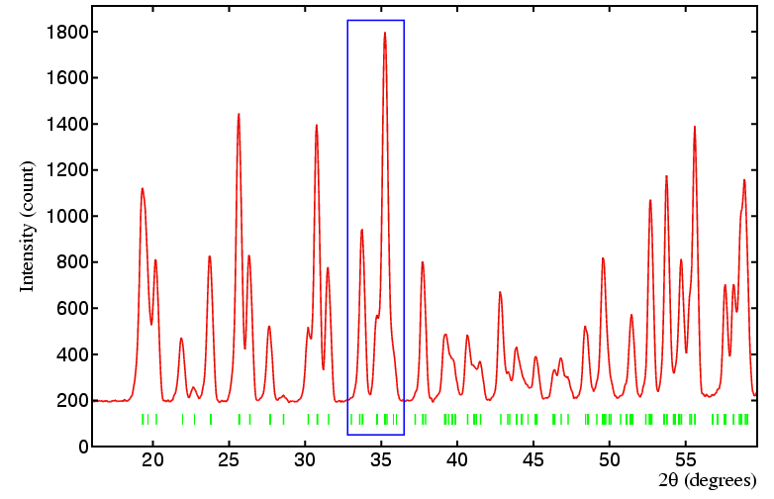
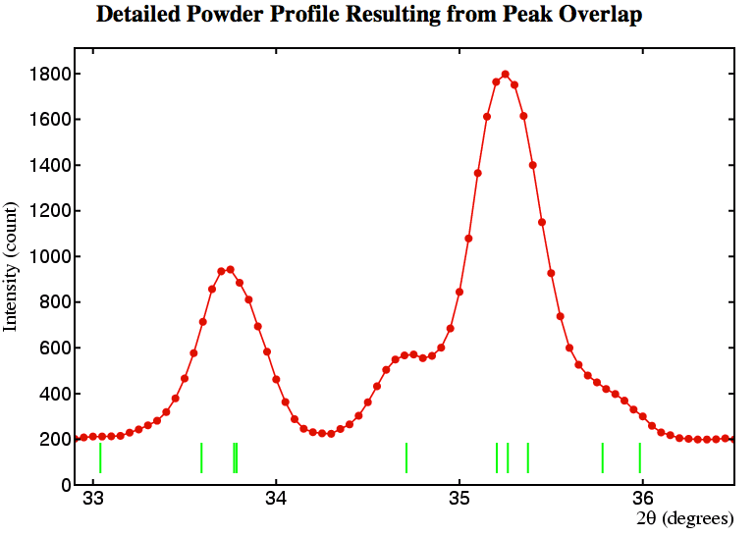
Powder Diffraction – Complex Patterns???
How to proceed with overlapping peaks?
There are 10 peaks in the highlighted region!

Slide 18
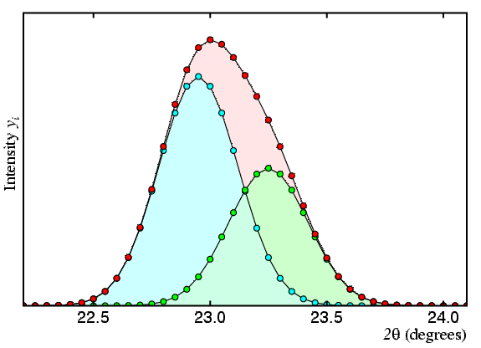
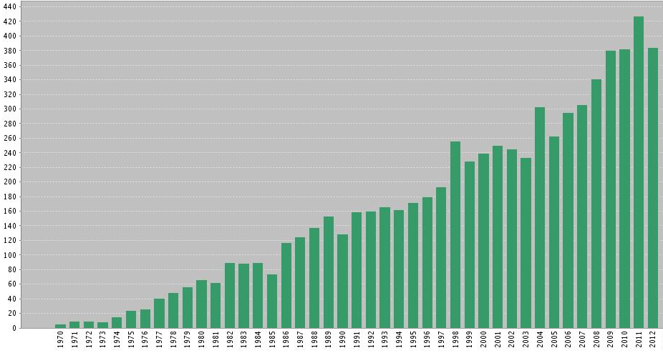
Rietveld Method - 1969
Available 1972 onwards:
The Rietveld method analyses powder diffraction data by a curve-fitting procedure, rather than measuring individual I_{hkl} values. Initially used a Gaussian shape function for neutron data, it was extended in 1977 to X-ray data (with more complex shape functions).
H. M. Rietveld, J. Appl. Cryst. 2, 65 (1969) – 7099 citations
11,355 papers have Rietveld in the abstract or key words!

Slide 19
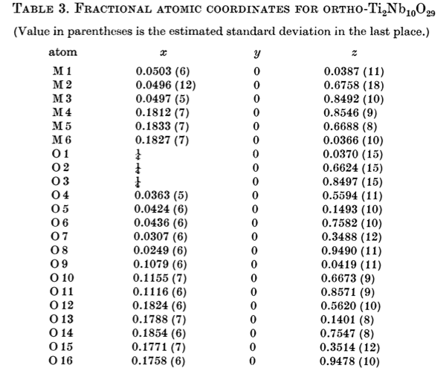
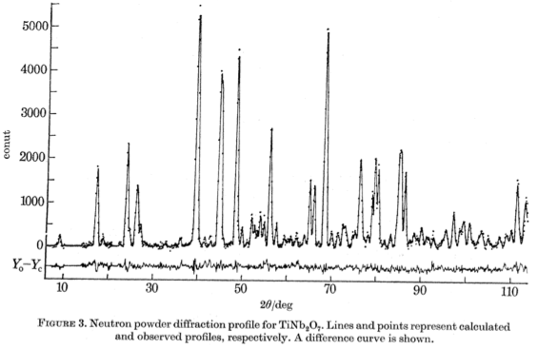
Rietveld Method Refinement of
Complex Structures: TiNb₂O₇ and Ti₂Nb₁₀O₂₉
Post-1972:
Remember that the Rietveld method is for refinement only and does not solve structures. It requires prior knowledge of the unit cell, space group, and approximate starting coordinates for the least squares
Von Dreele & Cheetham, Proc. Roy. Soc. A 338, 331 (1974)

Slide 20
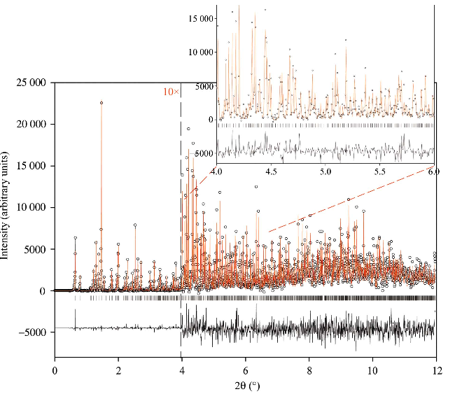
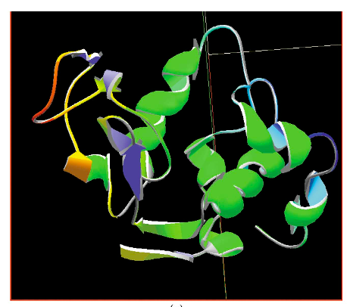
Very Complex Structures – Proteins!
2005: Synchrotron X-ray diffraction with proteins
Solution and refinement of the structure of hexagonal turkey egg-white lysozyme: hexagonal, space group P6₁22, unit-cell parameters a=71.0862 (3), c=85.0276 (5) Α
Margiolaki, Wright, Fitch, Fox & Von Dreele, Acta Cryst. D61, 423 (2005)

Slide 21
Can we make Amorphous ZIFs?
Silica is well-known as a glass-forming material. Can we do the
same thing with a ZIF?
Notes:
21

Slide 22
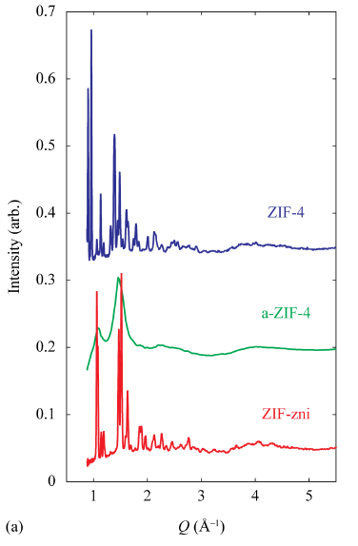
High Temperature Neutron Diffraction of ZIF-4
Data collection with
perdeuterated ZIF-4
at ISIS
The initial ZIF-4 has an open structure which becomes apparently amorphous at ~300ºC and then recrystallises as the dense ZIF (zni) at ~400ºC
Bennett, Goodwin, Dove, Keen, Tucker,
Barney, Soper, Bithell, Tan & Cheetham
Phys. Rev. Lett. 104, 115503 (2010)

Slide 23
Pair Distribution Functions
Key points:
PDFs of ZIF-4, a-ZIF, and
zni are very different at large r
PDFs are very similar at short
R (less than 10Å)

Slide 24
Structure of Amorphous ZIF by RMC
Model of the a-ZIF derived from Reverse Monte Carlo simulations
Formation of
a-ZIF is
irreversible on
cooling. It can
be brought to
room temp.
ZIF-4 a-ZIF zni
Bennett et al. PRL, 104, 115503 (2010)

Slide 25
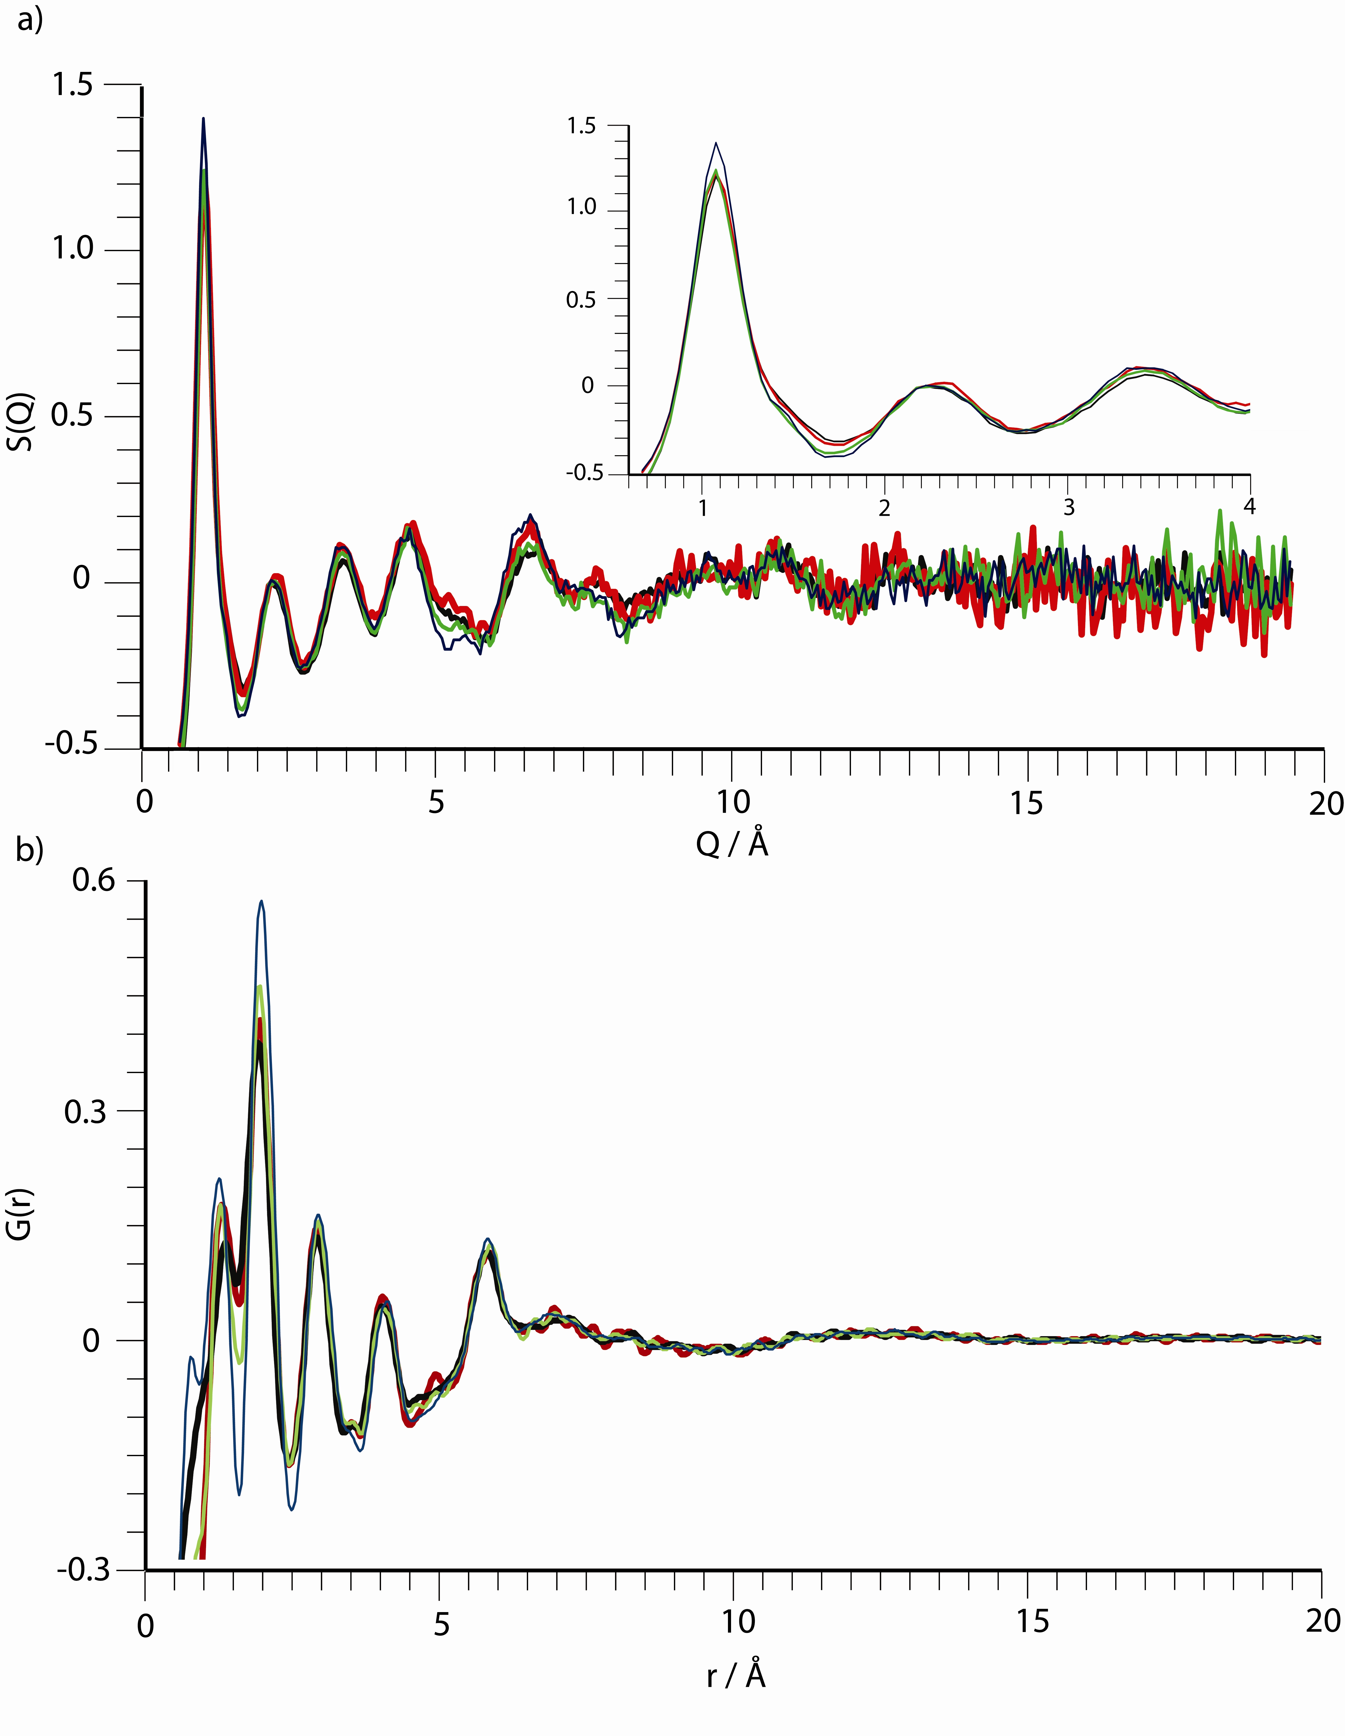
Can we make Amorphous ZIFs
from other ZIF Frameworks by Heating?
The Unsubstituted ZIFs – ZIF-1, ZIF-3 and Co-ZIF-4
all undergo amorphization to give a-ZIF with the same
structure as before, according to the X-ray pdfs and densities
T. D. Bennett, D. A. Keen, J-C. Tan, E. R. Barney,
L. Goodwin, and A. K. Cheetham, Angew. Chemie
Intl. Ed. 50, 3067 (2011)
Notes:
25

Slide 26
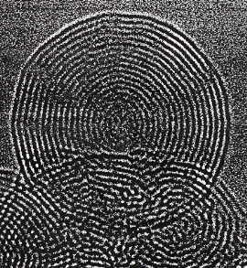
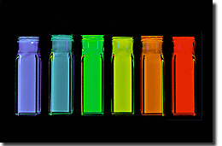
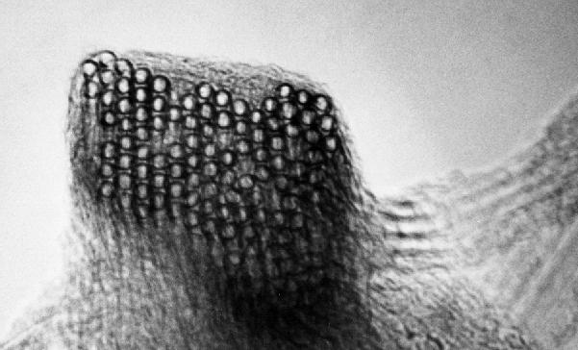
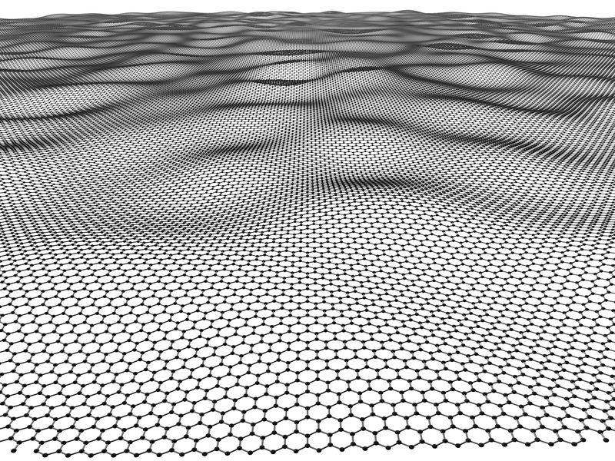
Major New Classes of Materials in the last 40 years
Supramolecular materials (1970s) *
Quasicrystals (1982) *
Conducting polymers (1982) *
Lithium electrodes for batteries (1984) ¶
High temperature superconductors (1986) *
Buckeyball, C₆₀ (1985) *
Carbon nanotubes (1991) §
Quantum dots (1992) §
GaN semiconductors (1993) #
Colossal magnetoresistive manganates (1993)
Inorganic-organic framework materials (1995)
Graphene (2004) *
* Nobel prize § Kavli prize
¶ Japan Prize # Millenium Prize
Notes:
26

Slide 27
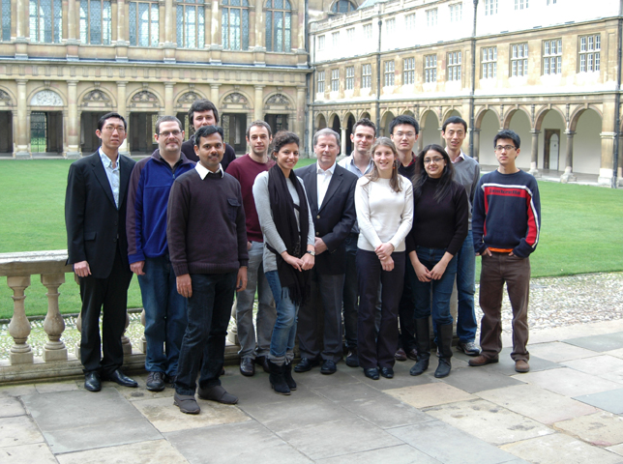
Thank You!
Cheetham Group today
at Trinity College, Cambridge!
£££: European Research Council,
Royal Society, EPSRC, Newton Trust,
Notes:
27

